Slide 1

Handy Verbs
Present Tense
With the Angry Family
To eat - manger

Slide 2
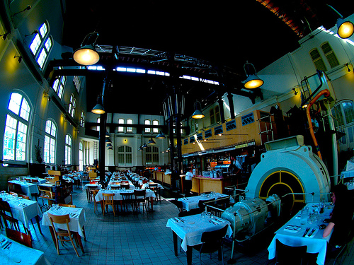
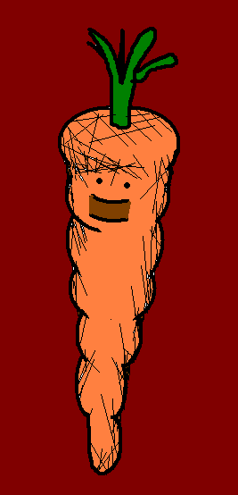


Je mange des carottes.
I eat carrots.

Slide 3
Toi aussi, tu manges des carottes?
Do you eat carrots?

Slide 4
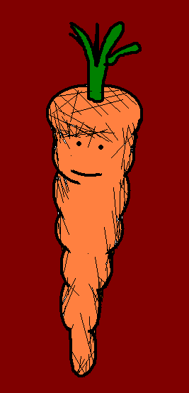
Il mange des carottes!!??
He eats Carrots!!??

Slide 5
Ah, elle ne mange pas de carottes.
Ah, she doesn’t eat carrots.

Slide 6


Peut-être qu’ils mangent des carrotes.
Maybe they eat carrots.
Notes:
Narrator is wolfman

Slide 7


No, on aime manger des pommes de terre.
No, we like to eat potato.
No, we like to eat potatoes.

Slide 8


Tu manges des pommes de terre?!?
Moi aussi!!!
You eat potatoes?!? Me too!!!

Slide 9
to eat - manger
I eat Je mange
You eat Tu manges
He/She/It eats Il/elle/on mange
We eat Nous mangeons
You (pl.) eat Vous mangez
They eat Ils/elles mangent

Slide 10













Join us again!

