Slide 1

Qui
With the Angry Family

Slide 2
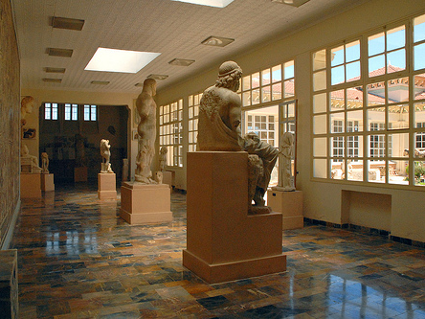
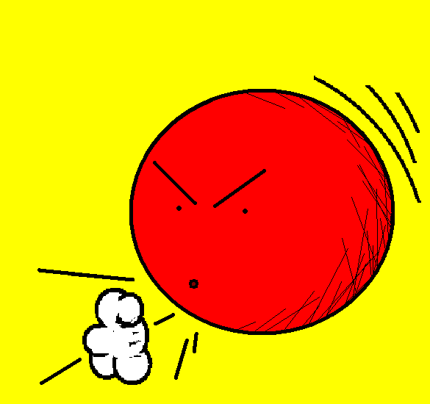
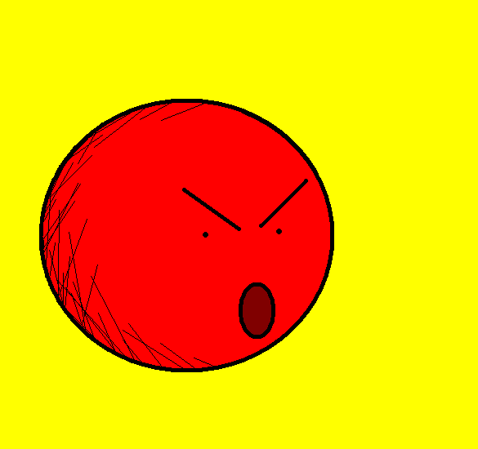

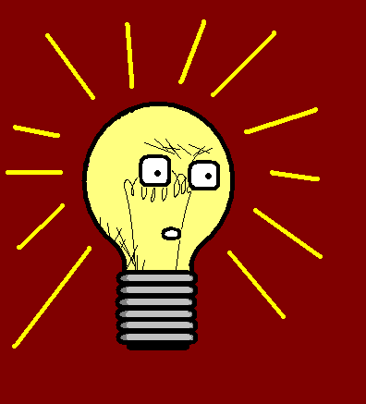
Bienvenue au musée de Slightly-Angry Parsnip Head.
Welcome to
the Slightly-Angry Parsnip Head Museum.

Slide 3

C’est mon grand-père qui l’a créé.
That is my grand-father who created it.

Slide 4
Ici, vous pouvez voir un fossile de choux, qui poussait il y a soixante seize siècles.
Here you can see a fossil cabbage that was growing seventy-six centuries ago.

Slide 5
Remarquez ce dessin de poireau magnifique, qui fut exécuté au Moyen Âge.
Notice this amazing leek figure that was drawn during the Middle Ages.

Slide 6
Vous pouvez admirer les détails de cette sculpture délicate, qui représente Lady Lettuce of Cold Wrath.
You can admire the details of this delicate sculpture that represents Lady Lettuce of Cold Wrath.

Slide 7
Quelle partie avez-vous appréciée le plus ?
Which was the part that you enjoyed most?

Slide 8
Vous avez fait référence à mon grand-père au début ; ça, c’était cool!
You mentioned my Grandfather at the beginning; that was cool!

Slide 9
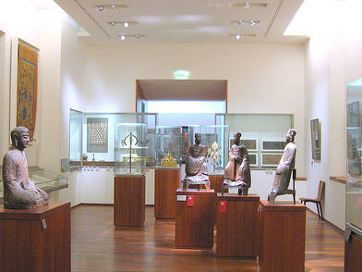
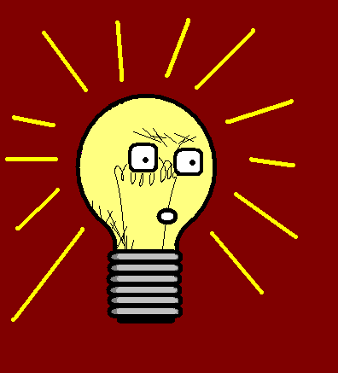
Grammar
Qui

Slide 10
Vous pouvez admirer les détails de cette sculpture délicate, qui représente Lady Lettuce of Cold Wrath.
You can admire the details of this delicate sculpture that represents Lady Lettuce of Cold Wrath.

Slide 11
Qui
You can admire the details of this delicate sculpture that represents Lady Lettuce of Cold Wrath.
This becomes
“You can admire the details of this delicate sculpture. This delicate sculpture represents Lady Lettuce of Cold Wrath.”
‘This delicate sculpture’ is the subject of the sentence because it is carrying out the action of the verb.
Therefore ‘that’ will translate as ‘QUI’.

Slide 12

















Join us again!

