Slide 1

Time Travel
With somebody who looks like
Mr. Angry Cloud-Ghost

Slide 2
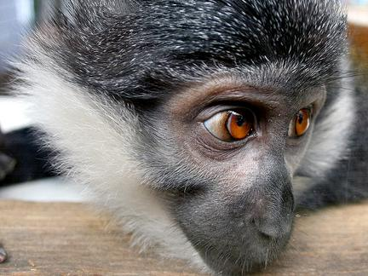
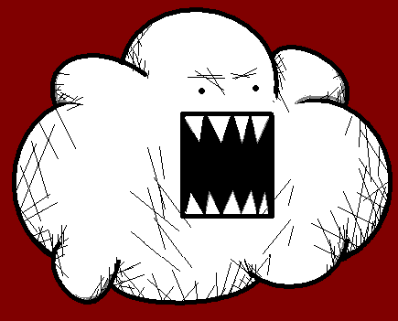
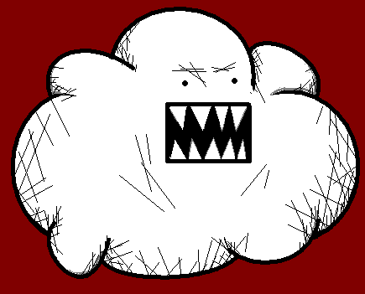
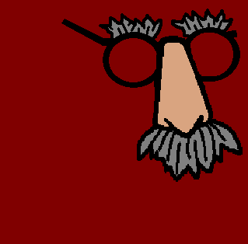
Hello, you! It is time for you to learn how to say the time... I am so funny...

Slide 3
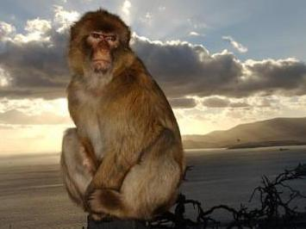
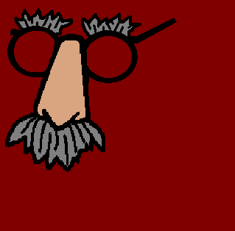
You already know how to say the time in English.

Slide 4
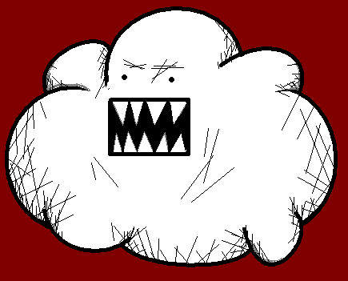
My glasses!!

Slide 5


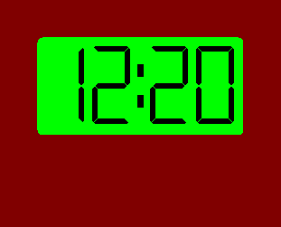
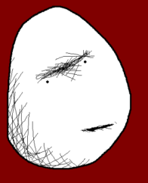
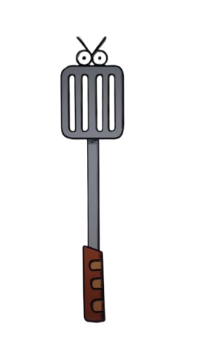
In English first you say the minutes: “It is twenty minutes past...”

Slide 6
... and then you say the hours: “It is twenty minutes past twelve”.

Slide 7
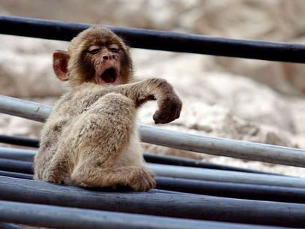
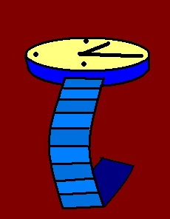
But things in French work differently.

Slide 8
So, in French firstly we need to give the hours: “Il est midi...”

Slide 9
And then the minutes: “Il est midi vingt.”

Slide 10
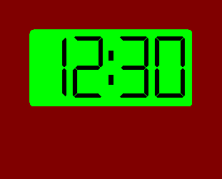
If it is a half past, we say: “et demi”, like in “Il est midi et demi.”

Slide 11
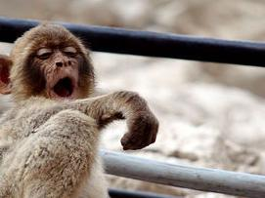

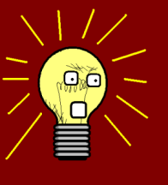

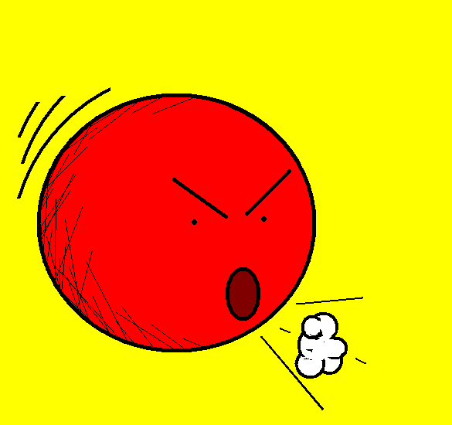


Or you can say “trente”

Slide 12
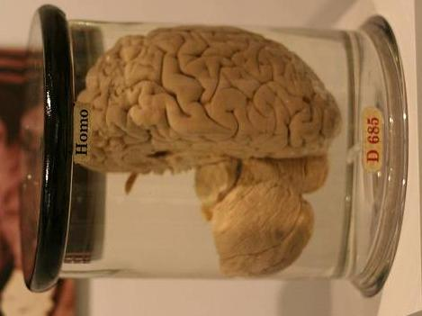
Can you remember how to say “thirty” in French?

Slide 13
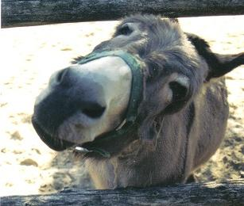
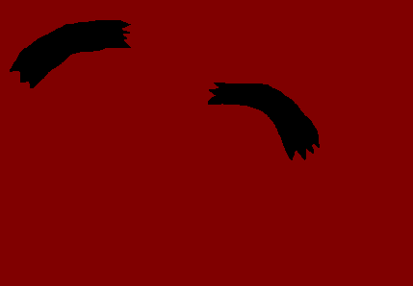
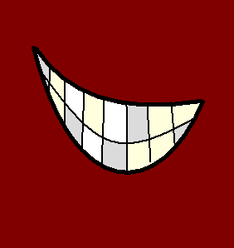
Of course you can’t!

Slide 14
It is “trente” and you need to pay more attention!!

Slide 15
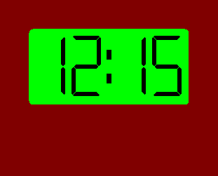
If it is a quarter past, in French we say: “et quart”, like in
“Il est midi et quart” .

Slide 16
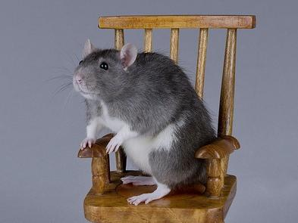
Or you can say “fifteen past”.

Slide 17
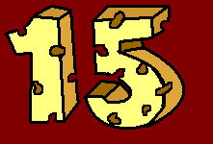
Can you remember how to say “fifteen” in French?

Slide 18
I don’t believe you!!! I think you are lying!!!

Slide 19
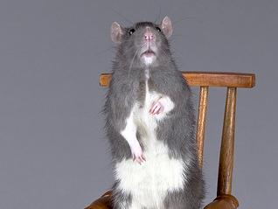
It is “quinze” and you still need to pay more attention!!

Slide 20
But what about when it is
“a quarter to”, not “a quarter past”?

Slide 21
Difficult question, isn’t it?

Slide 22
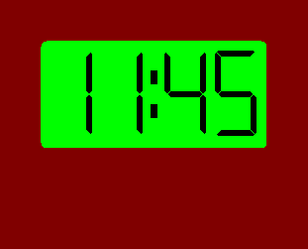
We need to say:
“moins le quart ”, like in
“Il est midi moins le quart”.

Slide 23
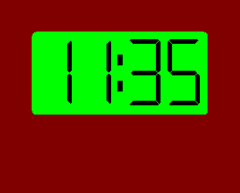
So, can you tell me (of course you can’t) how we say “it is twenty-five minutes to twelve” in French?

Slide 24


You are wrong, it is
“Il est midi moins vingt-cinq.”, HA!

Slide 25
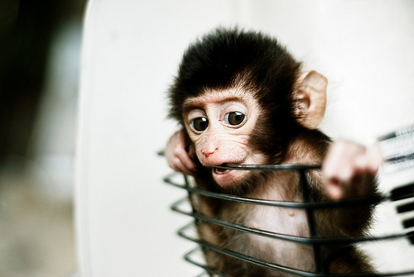
Before we say the hours we say “Il est”.

Slide 26
est…
Il

Slide 27
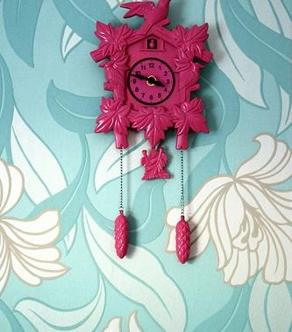
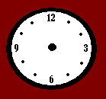


So, when we say minutes, we say “minutes”.

Slide 28
So, when we say hours, we say “heures”.

Slide 29
For half past:
“et demi”.
For a quarter past: “et quart”.

Slide 30
But for a quarter to: “moins le quart”.

Slide 31
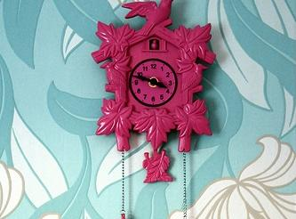
I’m sure you can remember all that. The next mystery is my identity. Mwahahahaha…

Slide 32
















Join us again!

