Slide 1



10 Survival Phrases
Survival Answers 1/6
With Mr Angry Potato Head and
Mrs. Mildly-Angry Carrot-Face

Slide 2


Hello I am the angry potato-head. I have already taught you ten survival phrases. Here are some answers.

Slide 3
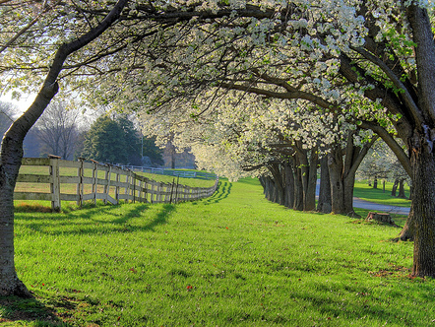


Hello. I am the mildly angry carrot-face. I am going to teach you answers to the survival phrases.

Slide 4
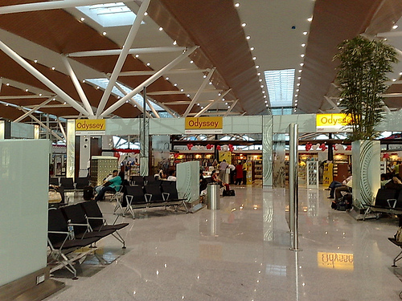
À quelle heure part l’avion ?
What time does the plane leave?

Slide 5
L’avion décolle dans cinq minutes.
The plane takes off in five minutes.

Slide 6
À quelle heure part l’avion ?
What time does the plane leave?

Slide 7
Je suis désolée, mais les portes ont fermé il y a cinq minutes.
I’m sorry but the gate closed five minutes ago.

Slide 8
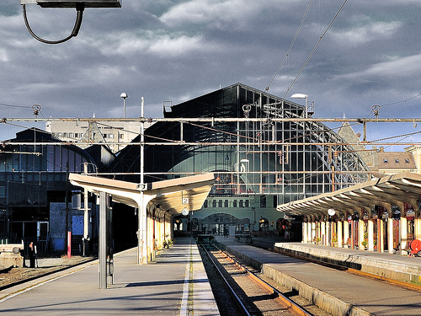
À quelle heure part le train ?
What time does the train leave?

Slide 9
Le train va partir dans quatre minutes.
The train will leave in four minutes.

Slide 10
À quelle heure part le train ?
What time does the train leave?

Slide 11
Vous n’êtes pas sur le bon quai.
You are not on the right platform.

Slide 12
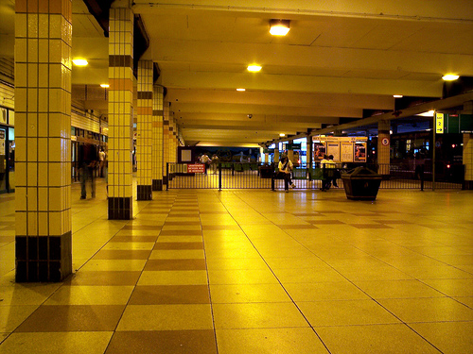

À quelle heure part le bus ?
What time does the bus leave?

Slide 13
Je ne sais pas. Vous devriez vérifier les horaires.
I don’t know, you should check the timetable.

Slide 14
À quelle heure part le bus ?
What time does the bus leave?

Slide 15
Je crois qu’il part d’ici dans dix minutes.
I think it departs from here in ten minutes.

Slide 16
















Join us again!

