Slide 1

Handy Questions 1
-
What Is Your Name?
With the Unusual Mike Rophone

Slide 2
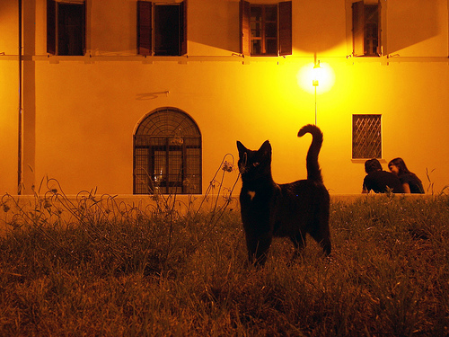


Hello. My name is the Unusual Mike Rophone. I like to ask questions, and so do you. Hahahahahaha.

Slide 3
Excusez-moi. Comment vous appelez-vous ?
Excuse me. What is your name?

Slide 4


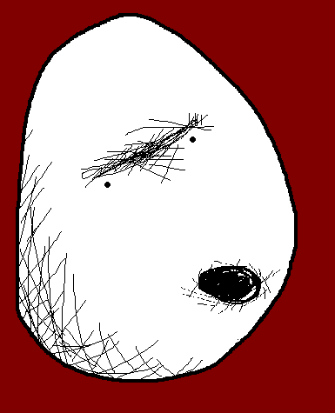
Bonjour ! Je m’appelle Angry Potato Head.
Hello, my name is Angry Potato Head.

Slide 5
Excusez-moi. Comment vous appelez-vous ?
Excuse me. What is your name?

Slide 6



Bonjour ! Je m’appelle Mrs Mildly-Angry Carrot-Face.
Hello. My name is Mrs Mildly-Angry Carrot-Face.

Slide 7
Excusez-moi. Comment vous appelez-vous ?
Excuse me. What is your name?

Slide 8
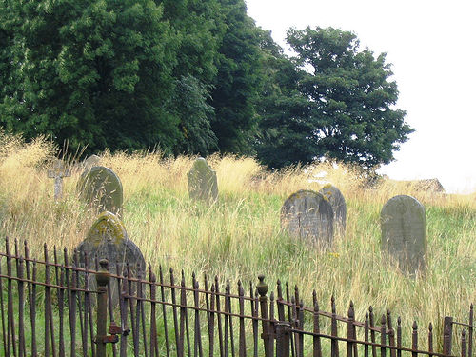


Salut ! Je m’appelle Miss Remotely Angry Lightening Bulb.
Hello. My name is Miss Remotely Angry Lightening Bulb.

Slide 9
Excusez-moi. Comment vous appelez-vous ?
Excuse me. What is your name?

Slide 10
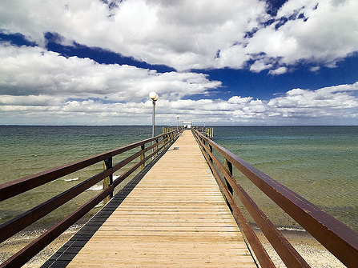


Salut ! Je m’appelle Mr Angry Toaster-Brow.
Hello. My name is Mr Angry Toaster-Brow.

Slide 11
Excusez-moi. Comment vous appelez-vous ?
Excuse me. What is your name?

Slide 12



Bonjour !
Je m’appelle Confused and Angry Wolfman.
Hello, my name is Confused and Angry Wolfman.

Slide 13
Excusez-moi. Comment vous appelez-vous ?
Excuse me. What is your name?

Slide 14



Bonjour ! Je m’appelle The Angry Cloud-Ghost.
Hello, my name is The Angry Cloud-Ghost.

Slide 15
Mmmm. I’m sure I had another question. But, I’ve forgotten it. Well it was nice speaking to you. Goodbye.

Slide 16















Join us again!

