Slide 1

Handy Questions 2
-
How Old Are You?
With the Unusual Mike Rophone

Slide 2
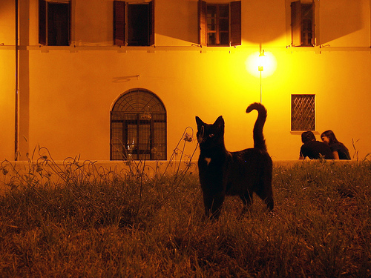

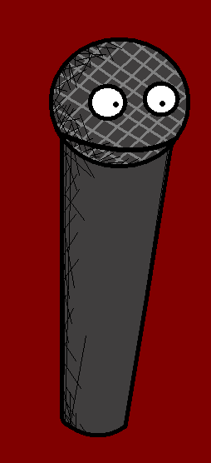
Hello. My name is the Unusual Mike Rophone. I like to ask annoying questions. Here’s one.

Slide 3
Quel âge as-tu ?
How old are you?

Slide 4
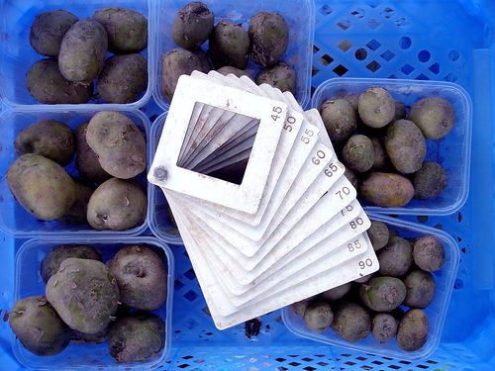
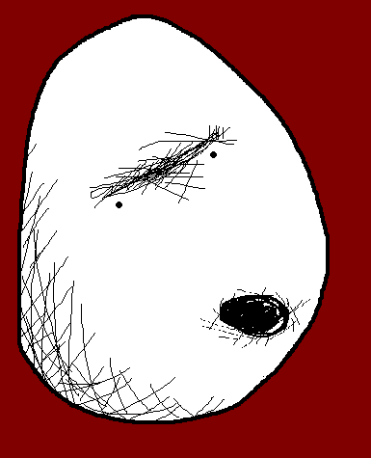

I am forty five years old.
J’ai quarante-cinq ans.

Slide 5
Quel âge as-tu ?
How old are you?

Slide 6
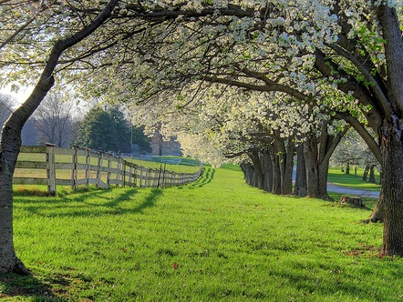


J’ai 30 ans.
I am 30 years old.

Slide 7
Quel âge as-tu ?
How old are you?

Slide 8
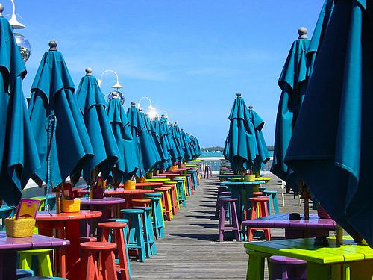


J’ai 15 ans.
I am 15 years old.

Slide 9
Quel âge as-tu ?
How old are you?

Slide 10
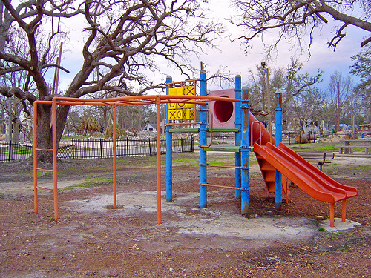


J’ai huit ans.
I am eight years old.

Slide 11
Quel âge as-tu ?
How old are you?

Slide 12


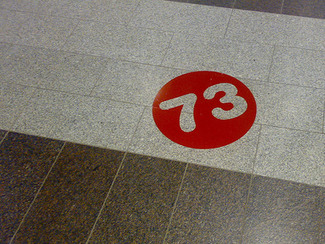
J’ai soixante-treize ans.
I am seventy three years old.

Slide 13
Quel âge as-tu ?
How old are you?

Slide 14



J’ai mille ans.
I am one thousand years old.

Slide 15
Mmmm. Thanks for your honesty.

Slide 16














Join us again!

