Slide 1

About Time
With Ms Remotely Angry Lightening Bulb

Slide 2
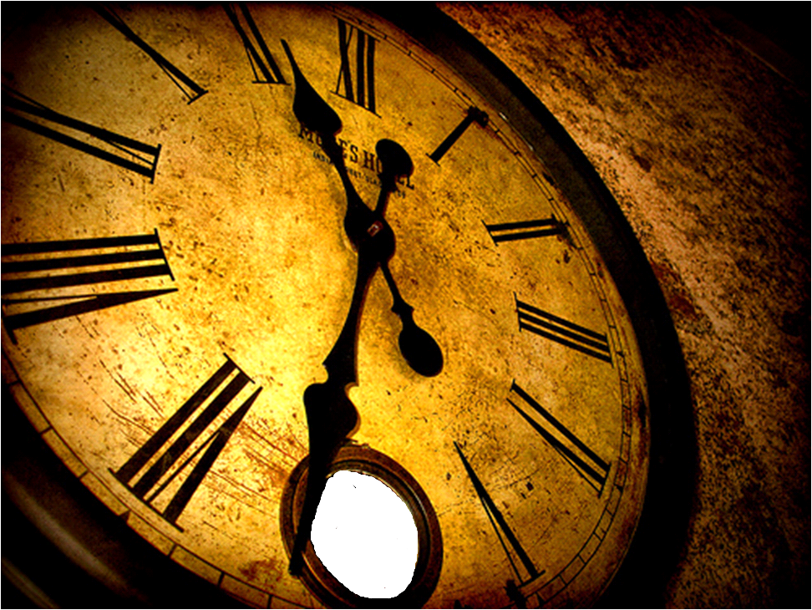
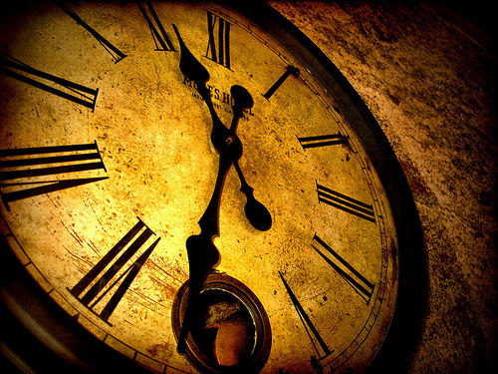
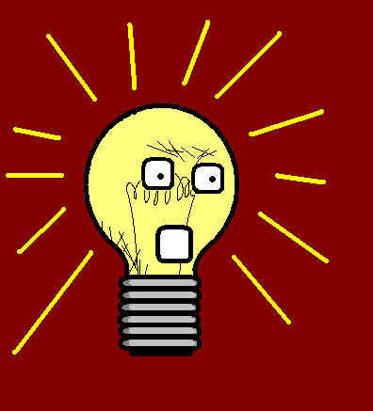
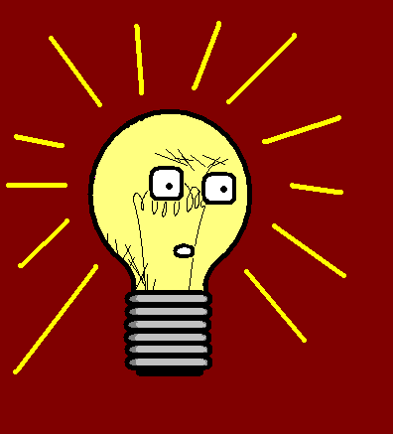
Hello, I am Miss Remotely Angry Lightening Bulb.
I have already taught you the basic time skills.

Slide 3
Now we will have a look at some more time telling.

Slide 4
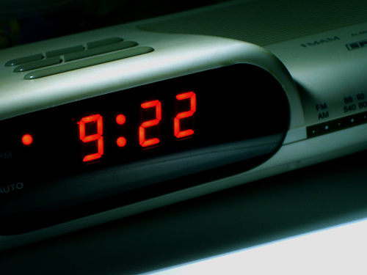
Unlike in English, ‘AM’ and ‘PM’ are not used. Watch out for the indicator in the conversation…

Slide 5
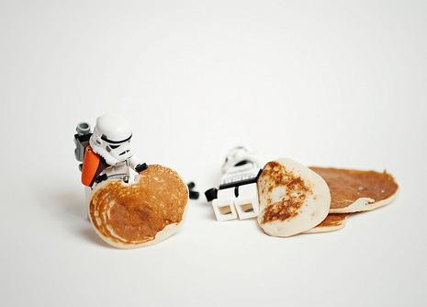
…Danke für das Frühstück. Bis heute Abend um 10 Uhr!
…urgh
-…Thanks for breakfast. I’ll see you at 10 o’clock tonight!
-…urgh

Slide 6
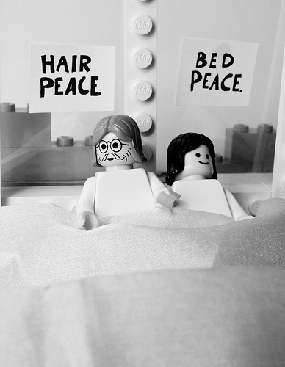
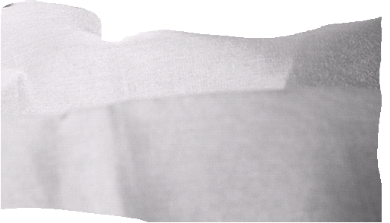
Um halb acht.
Wann müssen wir heute Abend im Kino sein?
- What time do we have to be at the cinema tonight?
- At half past seven.

Slide 7
Alternatively, you can also use the 24-hour clock…

Slide 8
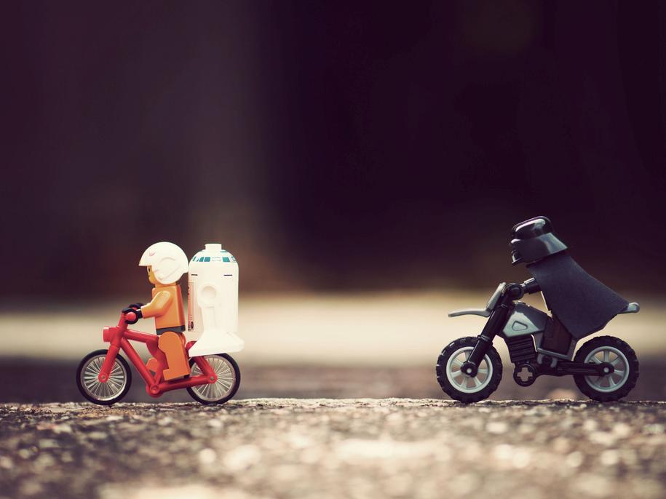
Fahr schneller!
‘Das Imperium schlägt zurück’
beginnt um 20:15.
For half past eight you say ‘halb’ and the NEXT hour!
Speed up! ‘The empire strikes back’ starts at 20:15.

Slide 9
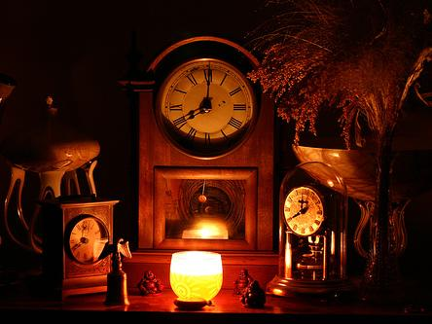
The further south in Germany you go, the more likely it is that you come across strange ways of giving the time…

Slide 10
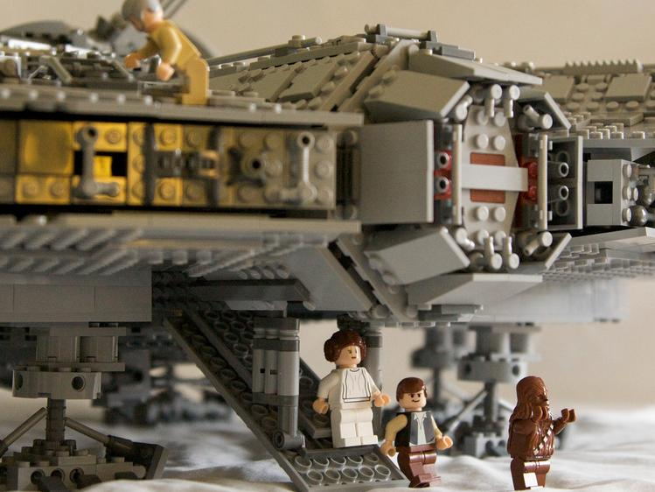
Wieviel Uhr ist es?
Viertel elf! (10:15)
- What time is it?
-10:15!

Slide 11
Er meint, es ist viertel nach zehn.
?
- ?
-He means it’s quarter past 10.

Slide 12
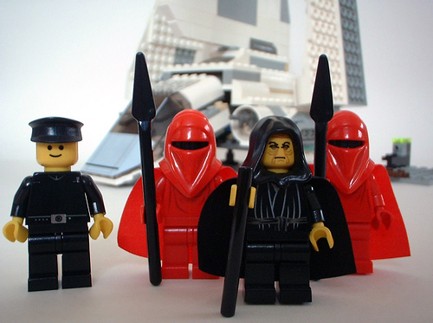
Warum halten wir hier? Ich habe einen Geschäftstermin um zehn nach vier!
Why do we stop here?
I have a meeting at ten past four!

Slide 13
Ich muss mal meine Beine ausstrecken. Es ist doch erst dreiviertel vier (3:45).
Was?
Mh?!
- I need to stretch my legs, it’s only 3:45.
-What?

Slide 14
Confused? Well yeah, even Germans do not always understand this.

Slide 15
















Join us again!

