Slide 1

Handy Verbs
Present Tense
With the Angry Family
To eat - essen

Slide 2
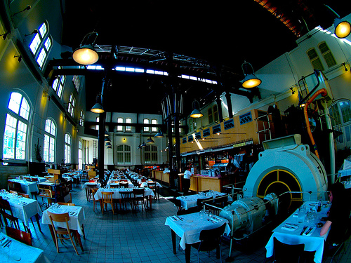


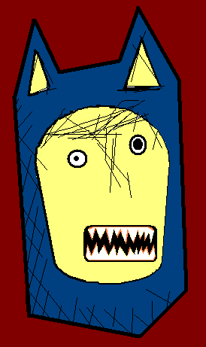
Ich esse Karotten.
I eat carrots.

Slide 3
Isst du Karotten?
Do you eat carrots?

Slide 4

Er isst Karotten!!??
He eats Carrots!!??

Slide 5
Ach, sie isst keine Karotten.
Ah, She doesn’t eat carrots.

Slide 6


Vielleicht essen sie Karotten.
Maybe they eat carrots.
Notes:
Narrator is wolfman

Slide 7


No, we like to eat potato.
Nein, wir essen gerne Kartoffeln.
No, we like to eat potatoes.

Slide 8


Ihr esst Kartoffeln?!?
Ich auch!!!
You eat potatoes?!? Me too!!!

Slide 9
to eat - essen
I eat Ich esse
You eat Du isst
He/She/It eats Er/Sie/Es isst
We eat Wir essen
You (pl.) eat Ihr esst
They eat Sie essen

Slide 10













Join us again!

