Slide 1

Time Travel
With somebody who looks like
Mr. Angry Cloud-Ghost

Slide 2
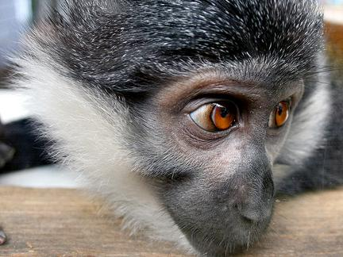


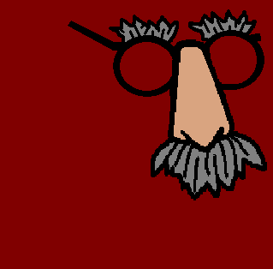
Hello, you! It is time for you to learn how to say the time... I am so funny...

Slide 3
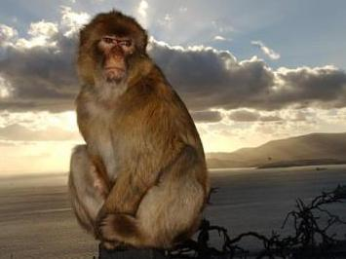
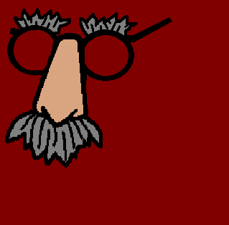
You already know how to say the time in English.

Slide 4

My glasses!!

Slide 5


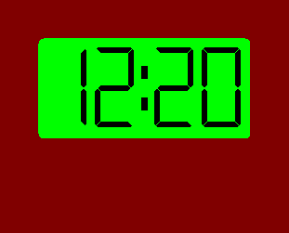
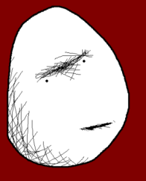
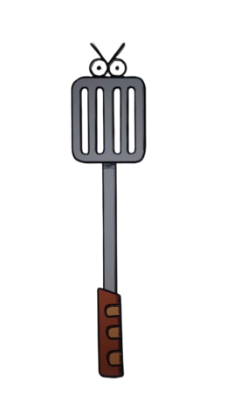
In English first you say the minutes: “It is twenty minutes past...”

Slide 6
... and then you say the hours: “It is twenty minutes past twelve”

Slide 7
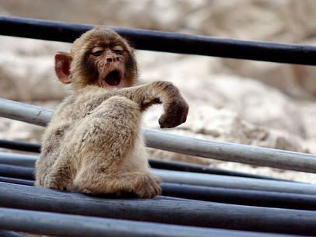
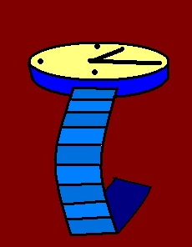
In German things don’t work very differently.

Slide 8
So, in German you can either give the hours first: “Es ist zwölf Uhr...”

Slide 9
And then the minutes: “Es ist zwölf Uhr zwanzig.”

Slide 10
Or you keep it easy and just do it like in English, first you say the minutes : “Es ist zwanzig Minuten nach...”

Slide 11
... and then you say the hours: “Es ist zwanzig Minuten nach zwölf.”

Slide 12
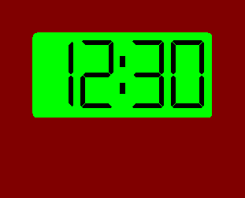
If it is a half past, we say: “halb” and then the NEXT hour , like in
“Es ist halb eins.”

Slide 13
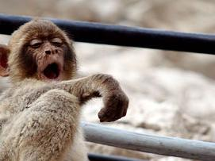



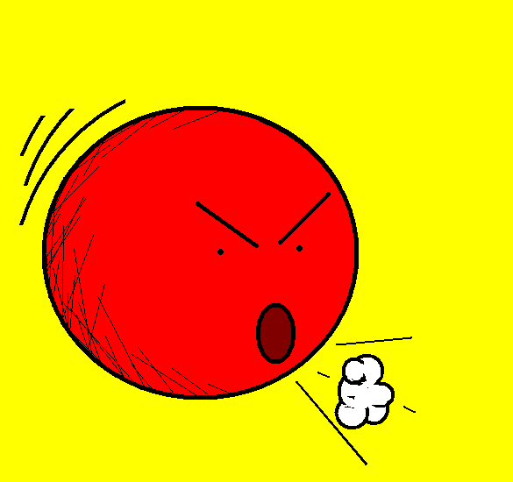


Or you can say “thirty past”

Slide 14
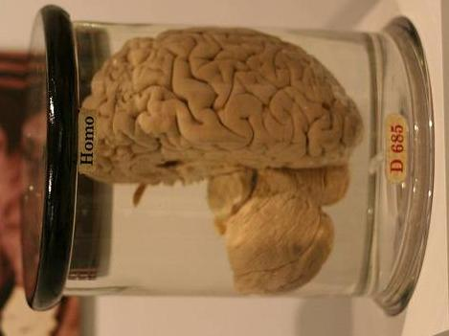

Can you remember how to say “thirty” in German?

Slide 15
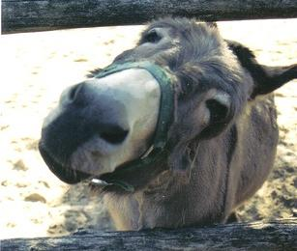
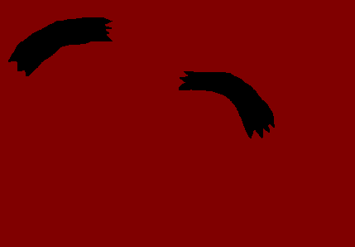
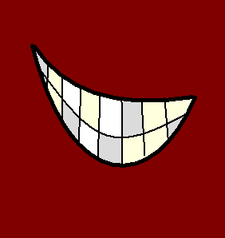
Of course you can’t!

Slide 16
It is “dreißig” and you need to pay more attention!!

Slide 17
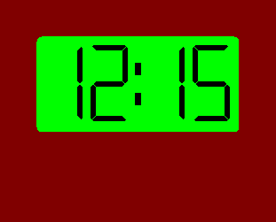
If it is a quarter past, in German we say: “viertel nach”, like in
“Es ist viertel nach zwölf” .

Slide 18
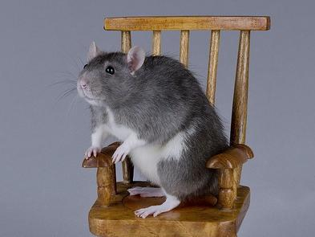
Or you can say “fifteen past”.

Slide 19
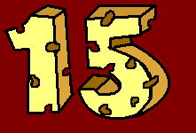
Can you remember how to say “fifteen” in German?

Slide 20
I don’t believe you!!! I think you are lying!!!

Slide 21
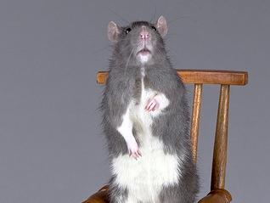
It is “fünfzehn” and you still need to pay more attention!!

Slide 22
But what about when it is
“a quarter to”, not “a quarter past”?

Slide 23
Difficult question, isn’t it?

Slide 24
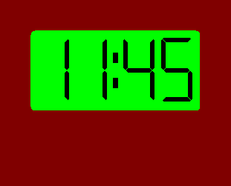
Actually no, we just need to say:
“viertel vor ”, like in
“Es ist viertel vor zwölf”.

Slide 25
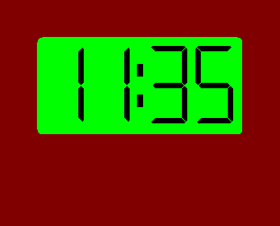
So, can you tell me (of course you can’t) how we say “it is twenty-five minutes to twelve” in German?

Slide 26
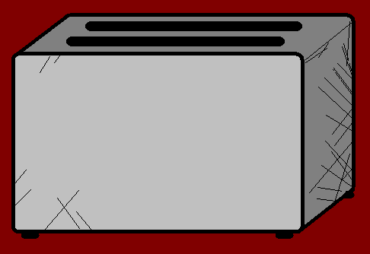

You are wrong, it could be
“Es ist elf Uhr fünfunddreißig.”, HA!

Slide 27
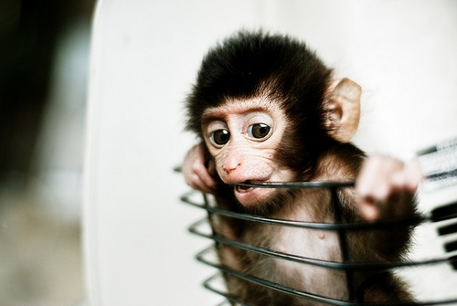
Before we say the hours we say “Es ist”.

Slide 28
ist…
Es

Slide 29
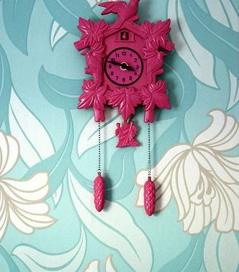
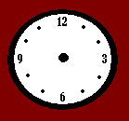


So, when we say minutes, we say “Minuten”.

Slide 30
And when we say hours, we say “Uhr”.

Slide 31
For half past:
“halb”
and the NEXT hour.
For a quarter past: “viertel nach”.

Slide 32
And for a quarter to: “viertel vor”.

Slide 33
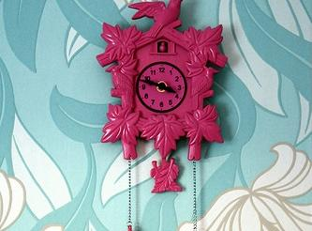
I’m sure you can remember all that. The next mystery is my identity. Mwahahahaha… Sigh.

Slide 34







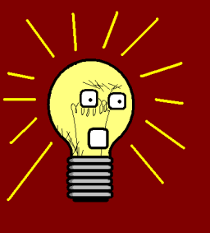








Join us again!

