Slide 1

10 Sentences You Will Never Need To Use

Slide 2

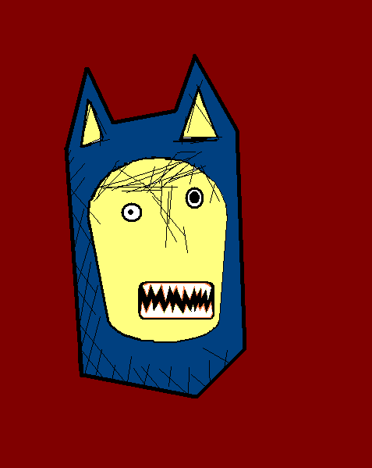
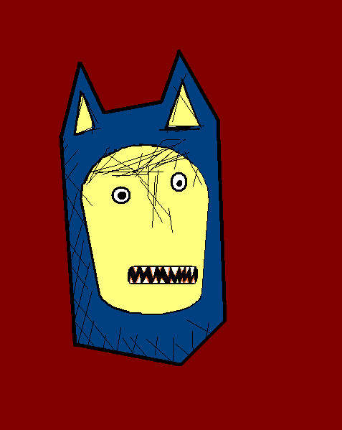
Hello. I’m the Confused and Angry Wolfman. I’m going to teach you ten phrases you will never need to use.

Slide 3

Mein Hamster hat leider eine Glatze.
My hamster is bald, unfortunately.
Notes:
My hamster is bald, unfortunately.

Slide 4

Bitte verkaufen Sie mir sofort all Ihre Kreide.
Sell me all your chalk at once, please.
Notes:
Sell me all your chalk at once, please.

Slide 5
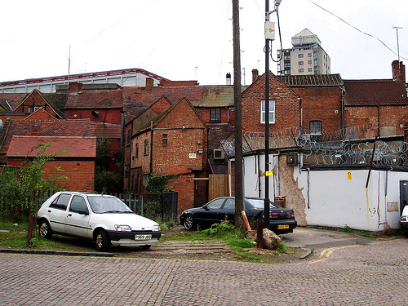
Könnten Sie das für mich pfeifen?
Can you whistle this for me?
Notes:
Can you whistle this for me?

Slide 6

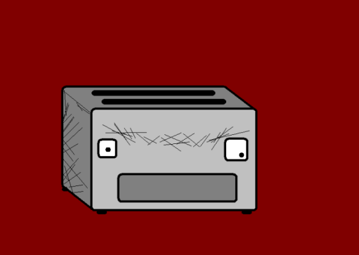
Der Toaster untersucht mich vorsichtig.
The toaster is investigating me carefully.
Notes:
The toaster is investigating me carefully. (mustert mich ?)

Slide 7

Ich wünsche mir oft, eine Gurke zu sein.
I often wish I was a cucumber.
Notes:
I often wish I was a cucumber.

Slide 8
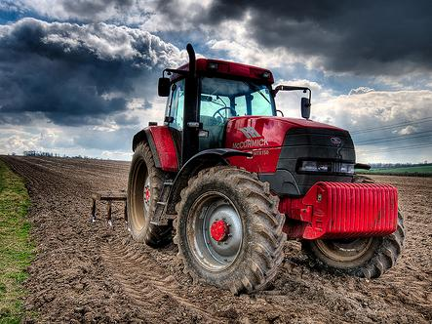
Was ist die Diagnose für dieses Ei?
What is the diagnosis for this egg?
Notes:
What is the diagnosis for this egg?

Slide 9

Ich glaube wirklich, dass Kritzeln ein sinnvoller Zeitvertreib ist.
I truly believe that doodling is a good use of my time.
Notes:
I truly believe that doodling is a good use of my time.

Slide 10

Why are you wearing those cushions?
Wieso haben Sie diese Kissen an?
Notes:
Why are you wearing those cushions? (tragen can mean carry as well as wear)

Slide 11

Apple juice doesn’t mix well with milk.
Apfelsaft verträgt sich nicht mit Milch.
Notes:
Apple juice doesn’t mix well with milk.

Slide 12
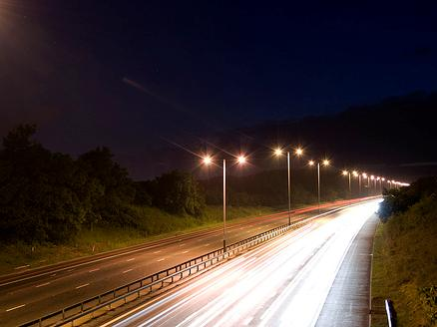
Hilfe! Die Welpen nagen an meinem Gehirn!
Help! The puppies are nibbling my brain.
Notes:
Help! The puppies are nibbling my brain.

Slide 13
















Join us again!

