Slide 1



The Angry Family
Miss Remotely Angry
Lightening Bulb

Slide 2
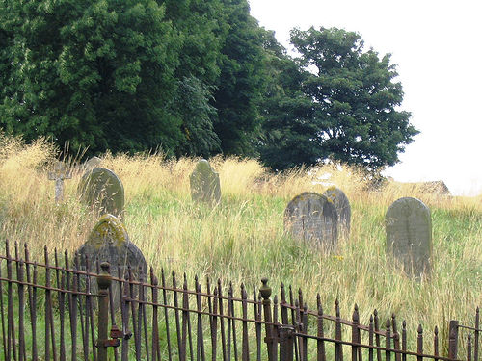
Hallo. Mein Name ist Miss Remotely Angry Lightening Bulb.
Hello. My name is Miss Remotely Angry Lightening Bulb.
Notes:
My name is Mrs Mildly-Angry Carrot-Face.

Slide 3
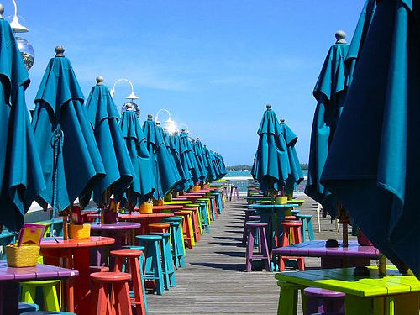
Ich bin fünfzehn Jahre alt.
I am 15 years old.
Notes:
I am 15 years old

Slide 4
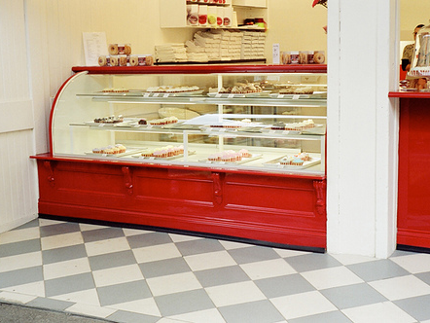
Ich lebe im Schrank unter der Treppe.
I live in the cupboard under the stairs.
Notes:
I live in the cupboard under the stairs.

Slide 5
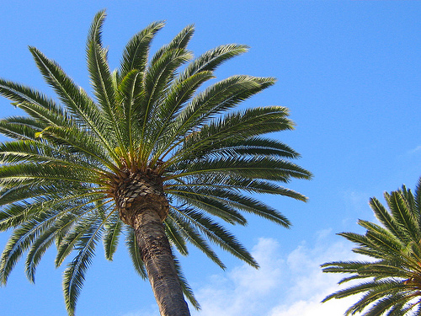
I have no brothers or sisters.
Ich habe keine Brüder oder Schwestern.
Notes:
I have no brothers or sisters.

Slide 6
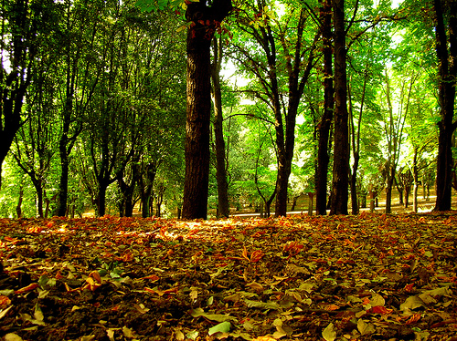
Ich mag Bäume, weil sie grün sind.
I like trees because they are green.
Notes:
I like trees because they are green.

Slide 7
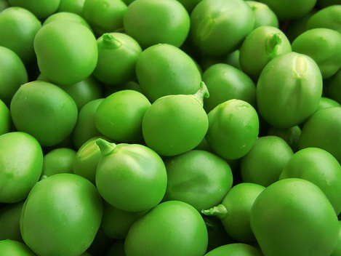
Erbsen mag ich nicht, weil sie zu klein sind.
I don’t like peas because they are too small.
Notes:
I don’t like peas because they are too small.

Slide 8
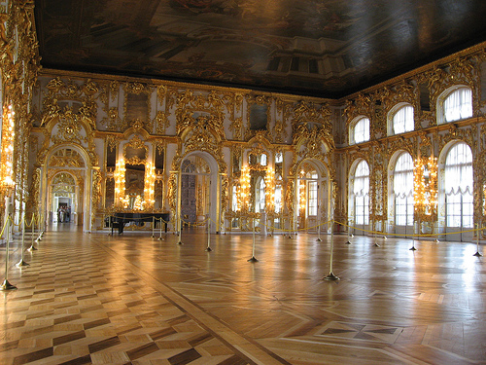
Gesellschaftstanz ist mein liebster Zeitvertreib.
Ballroom dancing is my favourite pastime.
Notes:
Ballroom dancing is my favourite pastime. (or just Tanz?)

Slide 9
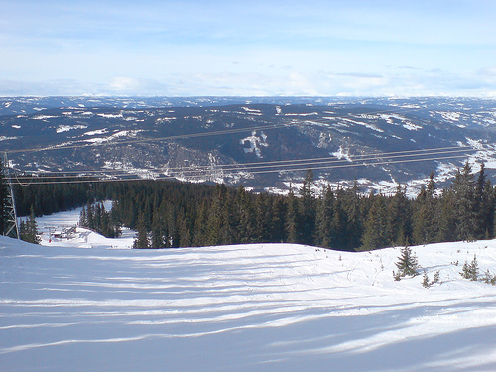
Ich will für eine Weile Skifahren gehen.
I want to go skiing for a while.
Notes:
I want to go skiing for a while. (or Schifahren) (auch:Zeitlang)

Slide 10
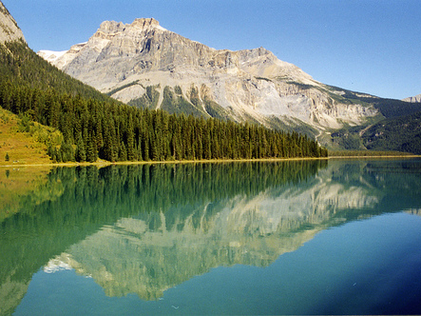
Leider war ich noch nie in Kanada.
I have never been to Canada unfortunately.
Notes:
I have never been to Canada, unfortunately.

Slide 11
















Join us again!

