Slide 1
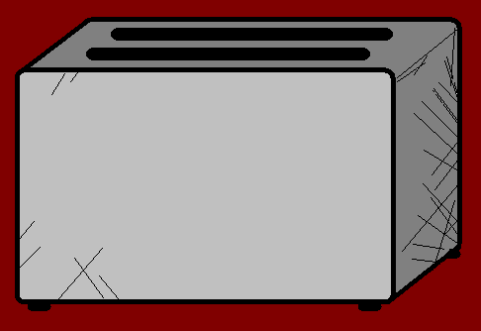



The Angry Family
Mr Angry Toaster-Brow

Slide 2
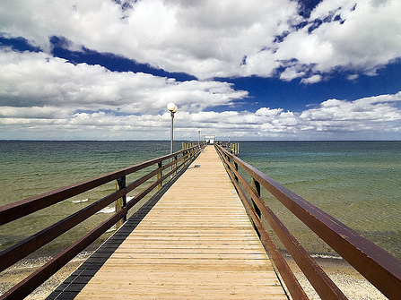
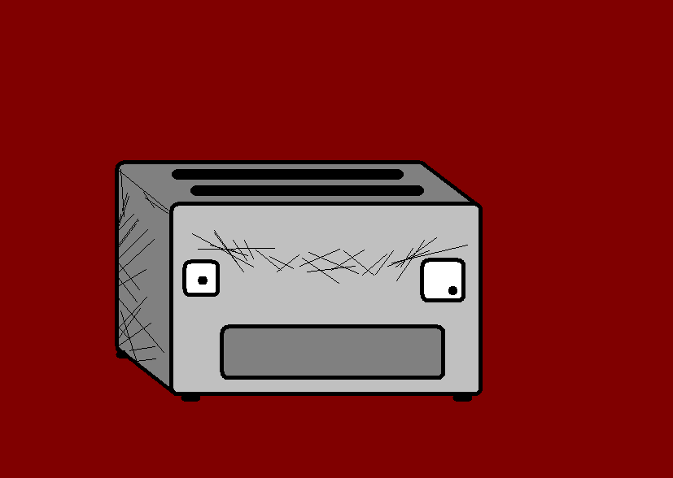
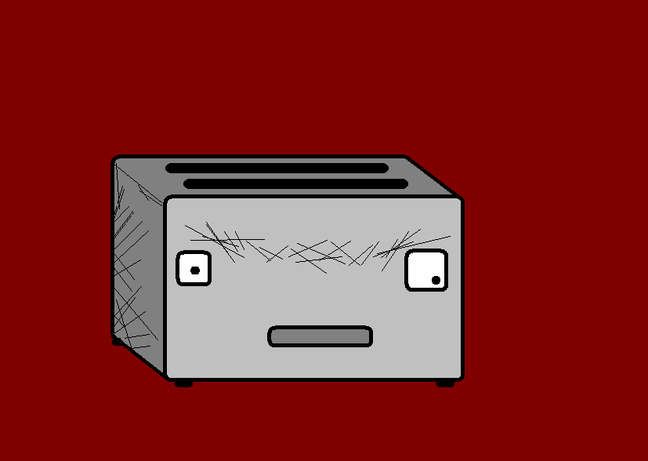
Hallo. Mein name ist Mr Angry Toaster-Brow.
Hello. My name is Mr Angry Toaster-Brow.
Notes:
Hello. My name is Mr Angry Toaster-Brow.

Slide 3
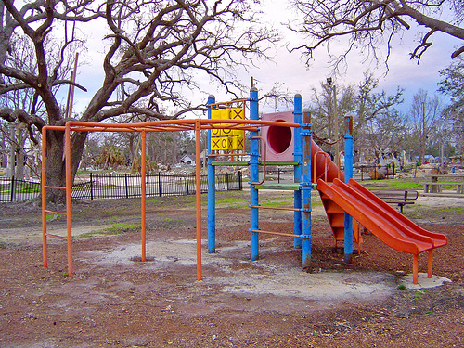
Ich bin acht Jahre alt.
I am eight years old.
Notes:
I am eight years old.

Slide 4
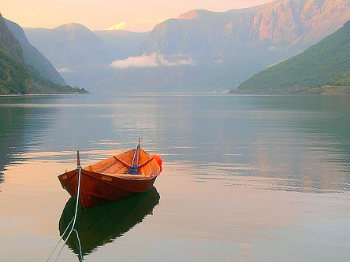
Ich lebe in Norwegen.
I live in Norway.
Notes:
I live in norway

Slide 5
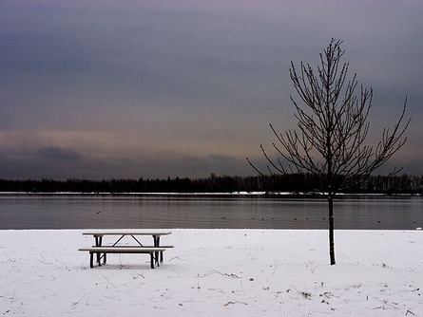
Ich habe einen Bruder und zwei Schwestern.
I have one brother and two sisters.
Notes:
I have one brother and two sisters.

Slide 6
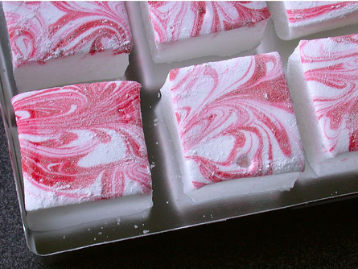
I like square things.
Ich mag viereckige Dinge.
Notes:
I like square things

Slide 7
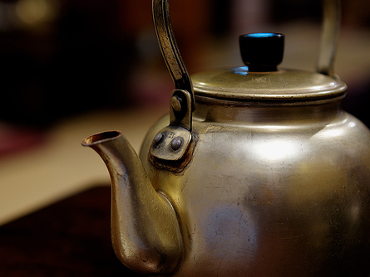
I don’t like kettles because they are noisy.
Wasserkocher mag ich nicht, weil sie so laut sind.
Notes:
I don’t like kettles because they are noisy.

Slide 8
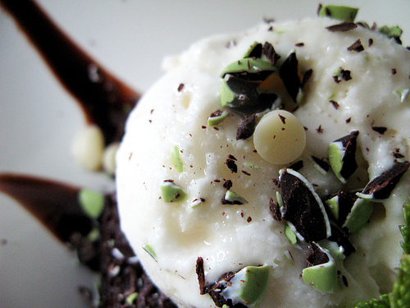
Mint chocolate chip is my favourite ice cream flavour.
Meine liebste Eis-Sorte ist Schokoladen-Minze.
Notes:
Mint chocolate chip is my favourite ice-cream flavour. (Schoko-Minz?)

Slide 9
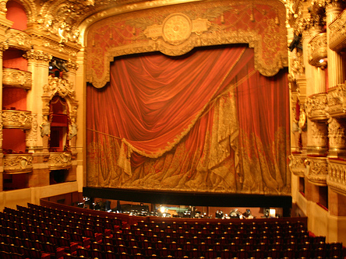
Ich will berühmt werden!
I want to be famous.
Notes:
I want to be famous

Slide 10
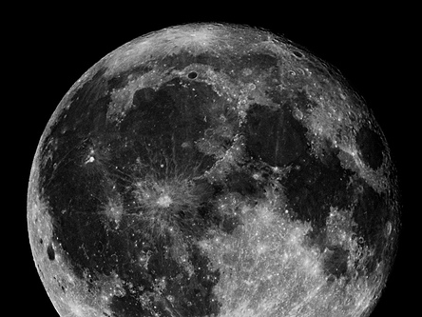
I scare people but I am quite nice really.
Ich mache den Leuten Angst, aber eigentlich bin ich ganz nett.
Notes:
I scare people but I am quite nice really.

Slide 11
















Join us again!

