Slide 1
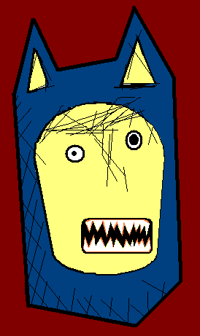



The Angry Family
Mr. Confused and Angry Wolfman

Slide 2
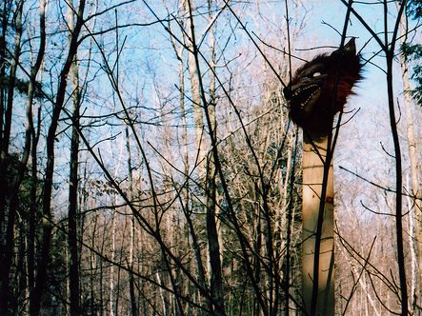
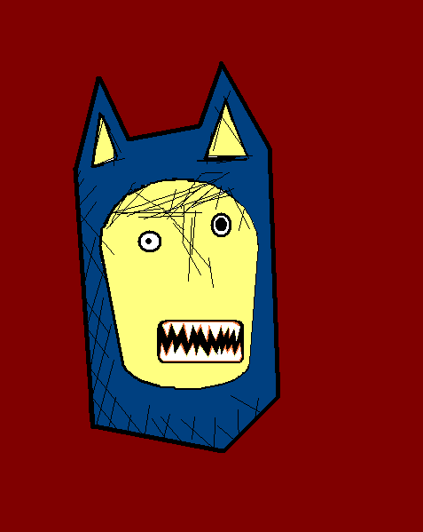
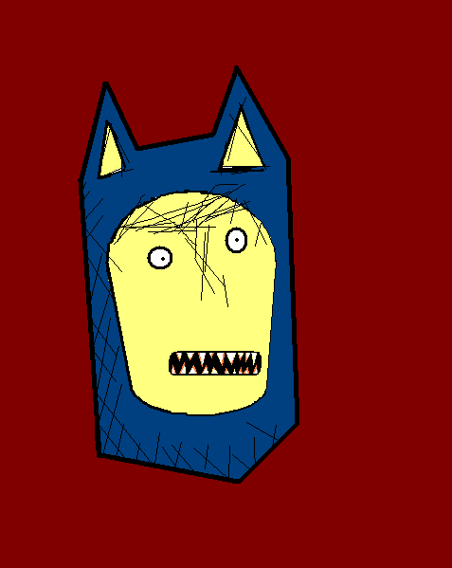
Hallo, mein Name ist Confused and Angry Wolfman.
Hello, my name is Confused and Angry Wolfman.

Slide 3

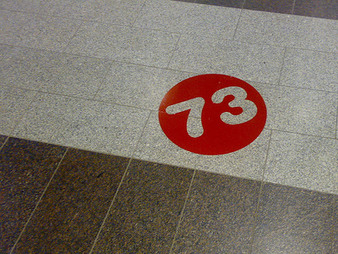
Ich bin dreiundsiebzig Jahre alt.
I am seventy three years old.
Notes:
I am seventy three years old.

Slide 4
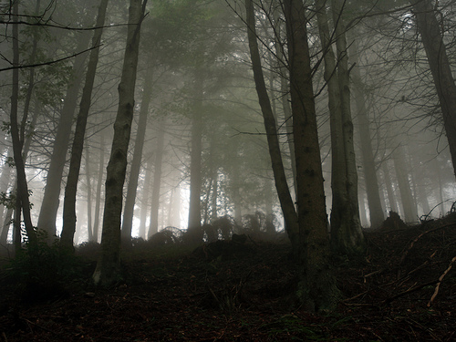
Ich lebe im Wald.
I live in the forest.
Notes:
I live in the forest.

Slide 5
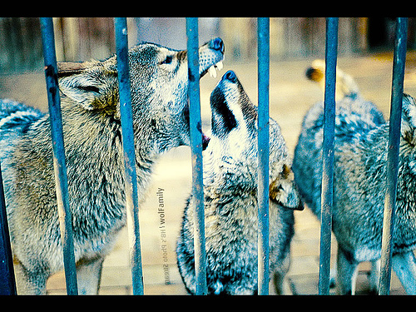
Ich habe drei Brüder und zwei Schwestern.
I have three brothers and two sisters.
Notes:
I have 3 brothers and 2 sisters.

Slide 6
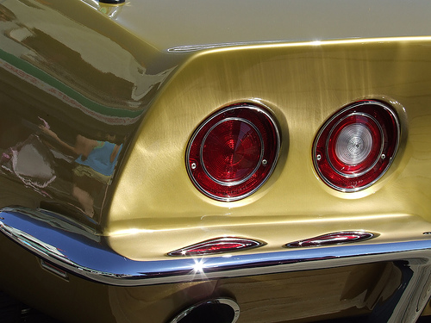
Ich mag Autos, weil sie glänzen.
I like cars because they are shiny.
Notes:
I like cars because they are shiny.

Slide 7
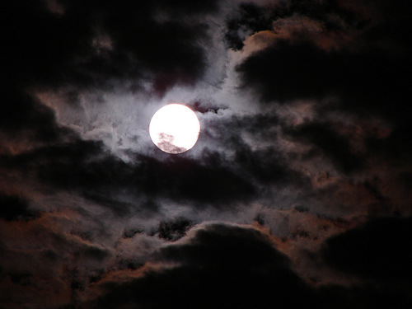
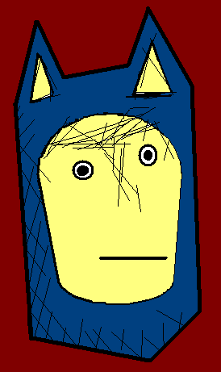
I don’t like the moon. It scares me.
Den Mond mag ich nicht. Er macht mir Angst.
Notes:
I don’t like the moon because it is scary.

Slide 8
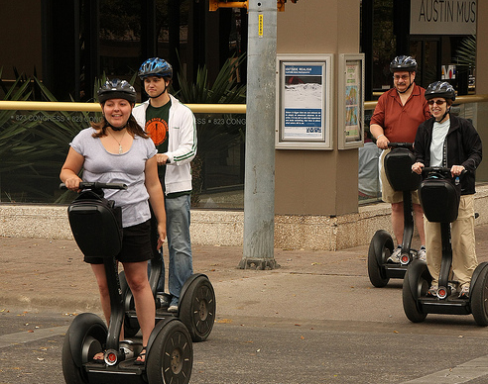
Samstag ist mein Lieblingstag.
Saturday is my favourite day.
Notes:
Saturday is my favourite day.

Slide 9
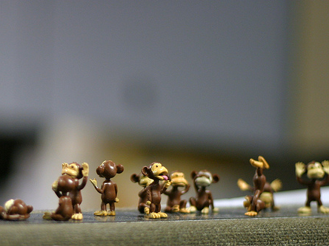
Ich will in den Zoo gehen, um die Affen zu sehen.
I want to go to the zoo, to see the monkeys.
Notes:
I want to go to the zoo, to see the monkeys.

Slide 10
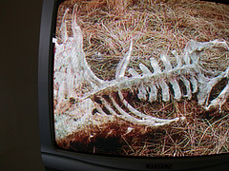
Ich fresse jeden, den ich sehe. Ich habe keine Freunde.
I eat everyone I see. I have no friends.
Notes:
I eat anyone I see. I have no friends

Slide 11














Join us again!

