Slide 1

Face to Clock Face
With Mr. Angry Toaster-Brow, The Radio and Miss Digitally Angry Clock-Face

Slide 2
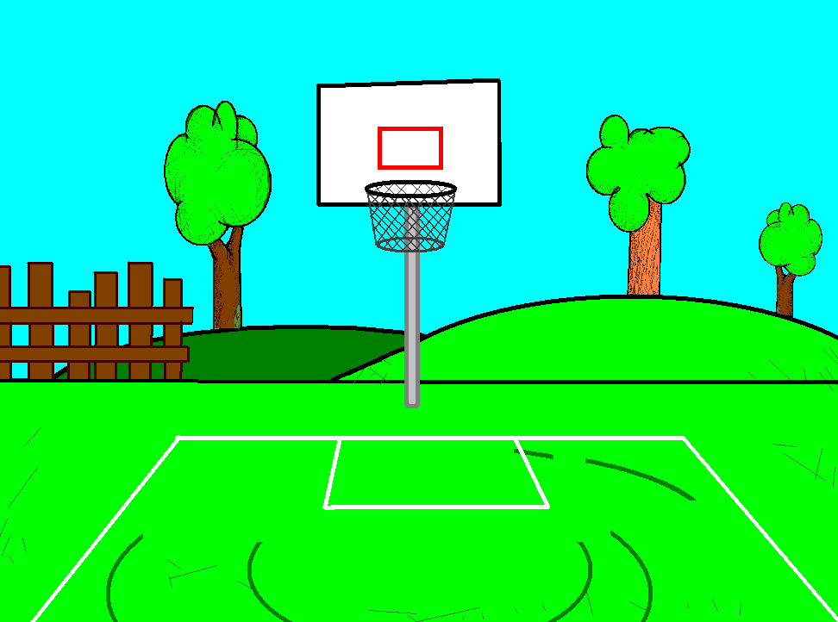


The radio believes he can win the love of my dear Miss (sweet) Digitally Angry
Clock-Face.

Slide 3
So we are going to have a duel to see who can read her the best.

Slide 4

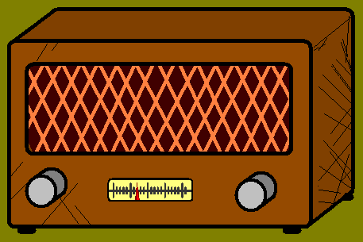

Slide 5
Mwahaha… There you are!

Slide 6
En garde!

Slide 7

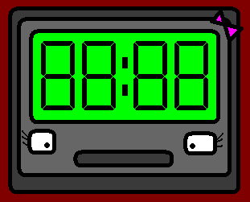

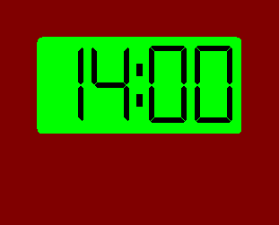

Slide 8
¡Son las TRES!
It is THREE!

Slide 9
¡No!
¡Son las DOS!
No! It is TWO!

Slide 10
Son las DOS en punto de la tarde.
It is TWO o’clock in the afternoon.

Slide 11
Mwahaha…
I won!

Slide 12
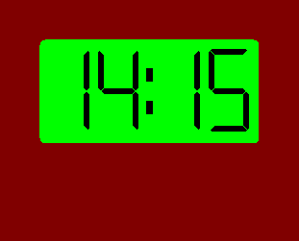

Slide 13
¡Son las dos Y cuarto!
It is a quarter PAST two!

Slide 14
¡No! ¡Son las dos MENOS cuarto!
No! It is a quarter TO two!

Slide 15
And the right time is… “¡Las dos Y cuarto de la tarde!”
And the right time is…
“Quarter PAST two in the afternoon!”

Slide 16
Ha, ha, ha, ha, I am closer to the love of my sweet clock!

Slide 17
Never! One more go!

Slide 18
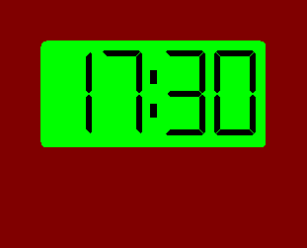

Slide 19
It is easy, “son las cinco y media.”
It is easy, “it is half past five”

Slide 20
Not fair, I was about to say the same!
¡Son las cinco y media!

Slide 21
You are both right, my dears, “son las cinco y media.”
You are both right, my dears,
“it is half past five.”

Slide 22
We need to have a tie-breaker, and the winner will take me to dinner.

Slide 23
It will be me,
I am sure.

Slide 24
Shut up, you!

Slide 25
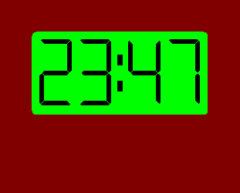

Slide 26
It is too much,
I can’t work it out!

Slide 27
I can see myself now with my sweet clock.

Slide 28
Faltan trece minutos para las… las…
It is… thirteen to… to… to…

Slide 29
¡Son las ONCE menos trece minutos!
It is thirteen to ELEVEN!!

Slide 30
¡Las… DOCE!
To… TWELVE!

Slide 31
Son las DOCE menos trece minutos,
¡no las ONCE!
It is thirteen to TWELVE at, not to ELEVEN!!

Slide 32
My dear toaster… You finally won my love, it is all yours!!

Slide 33















Join us again!

