Slide 1

Grammatical Gender in Spanish (Girl’s stuff and Boy’s stuff)
With Mr. Angry Cloud-Ghost and
Mrs Mildly-Angry Carrot-Face

Slide 2
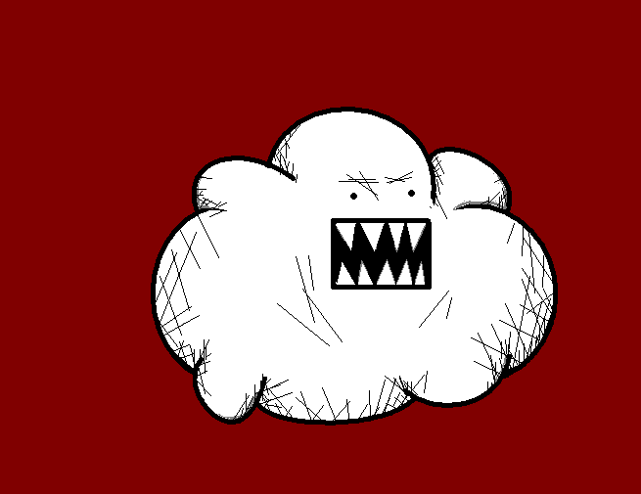
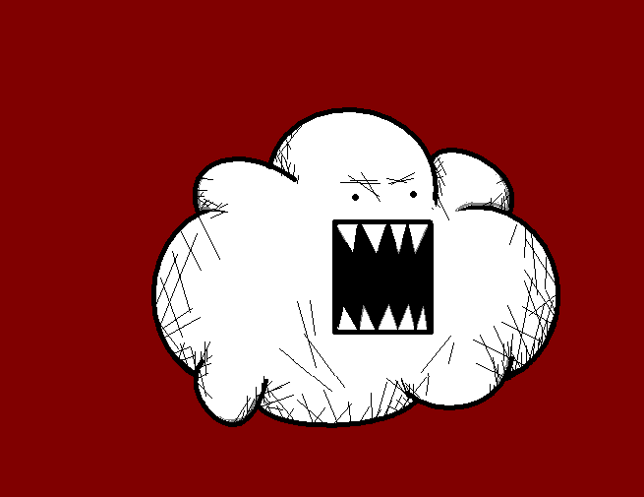
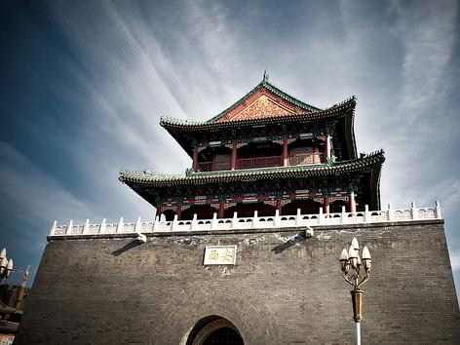
Ahhrr!! I am Mr. Angry Cloud-Ghost and I am going to talk to you about something really scary... Mwahaha...

Slide 3
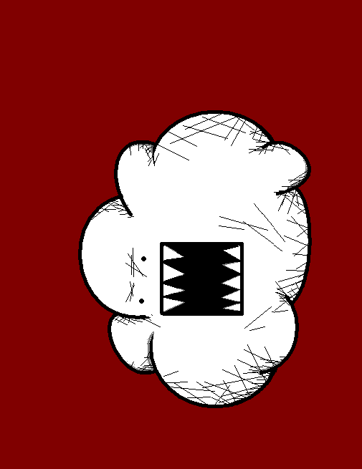
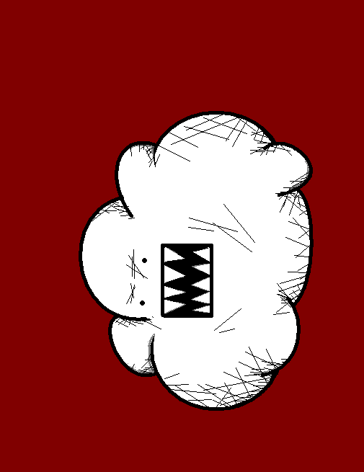
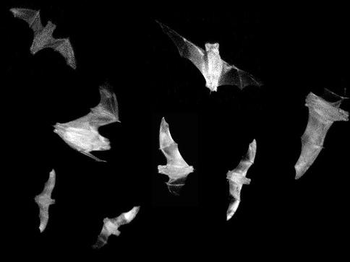
The Grammatical Gender in Spanish!!

Slide 4

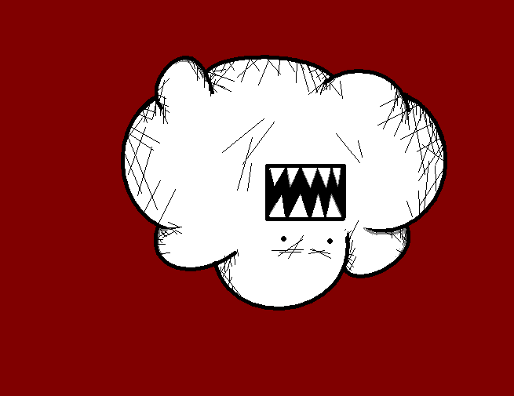
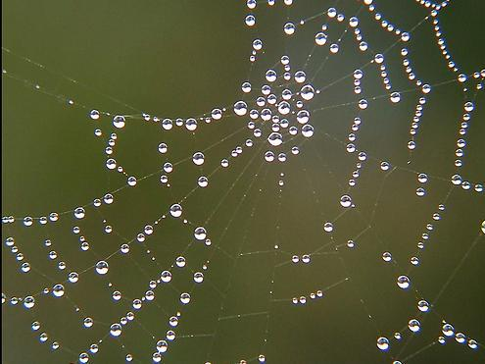
People and animals are either MALE (masculine)
or
FEMALE (feminine)

Slide 5
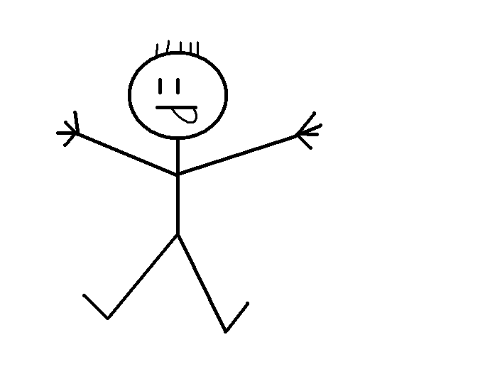
The boy (male)

Slide 6
El niño (male, masculine word)

Slide 7
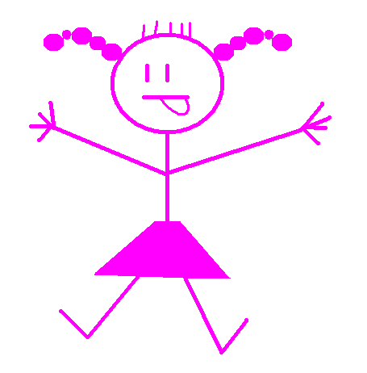
The girl (female)

Slide 8
La niña (female, feminine word)

Slide 9
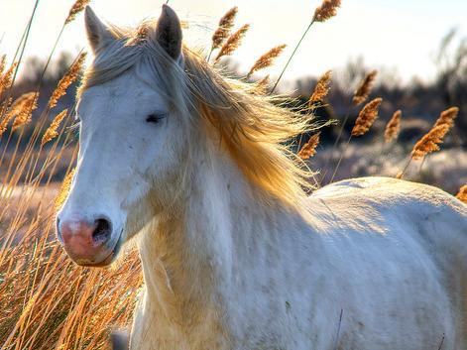
The horse (male)

Slide 10
El caballo
(male, masculine word)

Slide 11
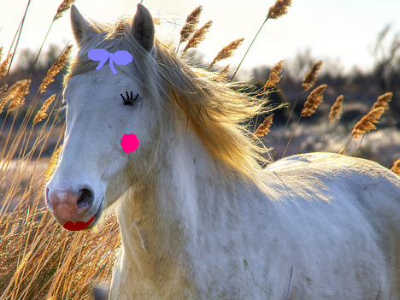
The mare (female)

Slide 12
La yegua
(female, feminine word)

Slide 13
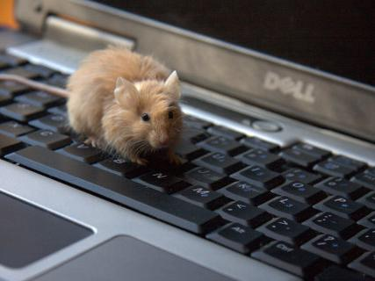
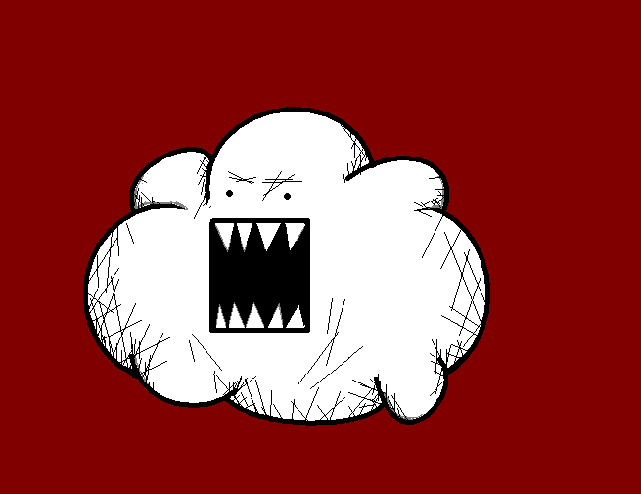
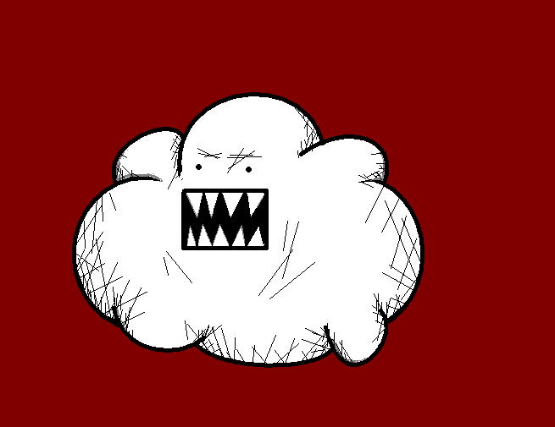
But Spanish is crazy because also things are either masculine or feminine!!

Slide 14
Let’s see some scary examples... Mwahaha...!!

Slide 15
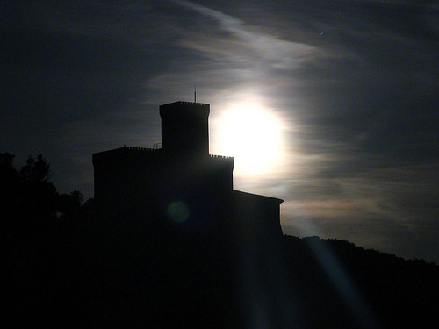
The castle

Slide 16
El castillo
(masculine word)

Slide 17
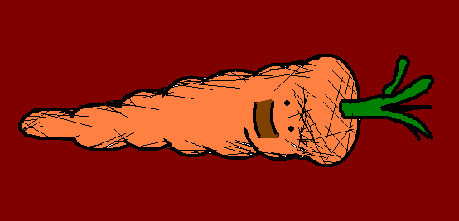
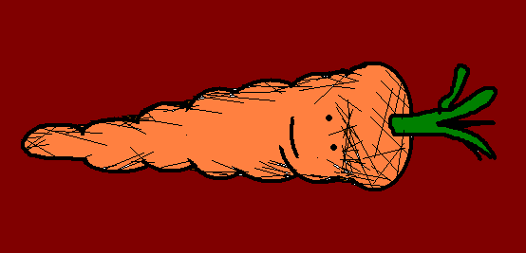
But WHY is “the castle” a masculine word?!

Slide 18
There is no reason WHY, Spanish is just crazy!! Mwahaha...!!

Slide 19
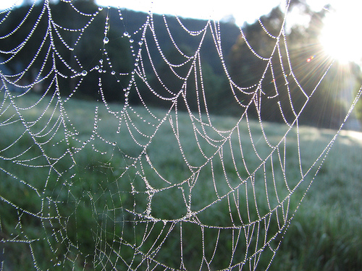
The spiderweb

Slide 20
La telaraña (feminine word)

Slide 21
But WHY is “the spiderweb” a feminine word?!

Slide 22
I told you before!! Spanish is just crazy!! Mwahahaha...!!

Slide 23
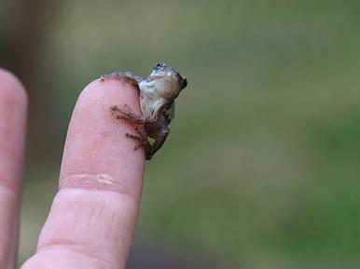
So, when we learn any new noun in Spanish we have to remember if it is...

Slide 24
A masculine word, like...

Slide 25
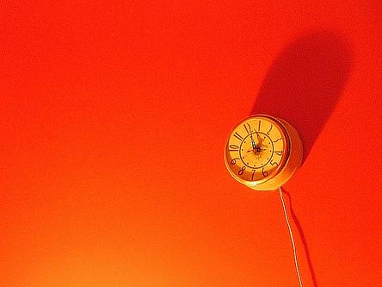
El reloj
(the watch)
(masculine word)

Slide 26
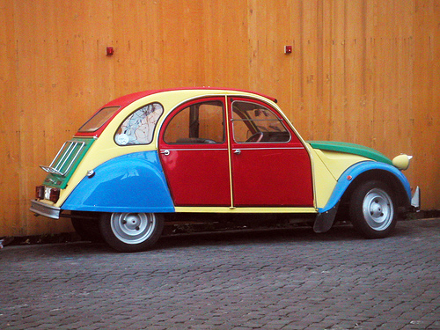
EL coche
(the car)
(masculine word)

Slide 27
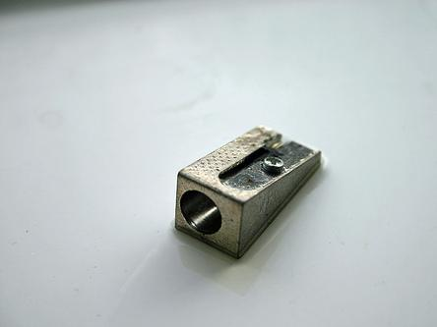
El sacapuntas
(the pencil sharpener) (masculine word)

Slide 28
Or...
A feminine word, like...

Slide 29
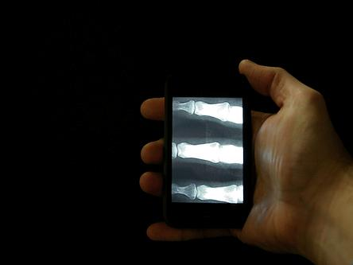
La mano
(the hand)
(feminine word)

Slide 30
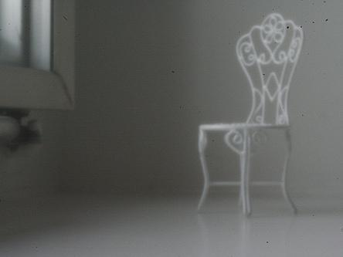
La silla
(the chair)
(feminine word)

Slide 31
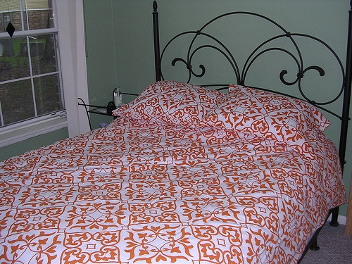
La cama
(the bed)
(feminine word)

Slide 32
And remember, there is no reason WHY!! Mwahahaha!!

Slide 33
















Join us again!

