Slide 1

Handy Subject Pronouns in Spanish (Singular Forms)
With the Angry Family

Slide 2
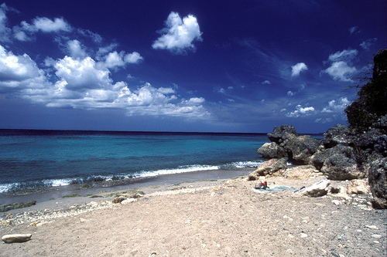


¡Hola, hola, hola!
I am Mr Angry Potato Head, and I am going to talk to you about the handy Subject Pronouns in English and in Spanish

Slide 3
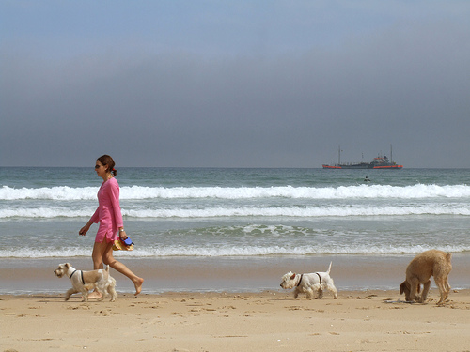
Now you might wonder... “What is a Subject Pronoun?”

Slide 4
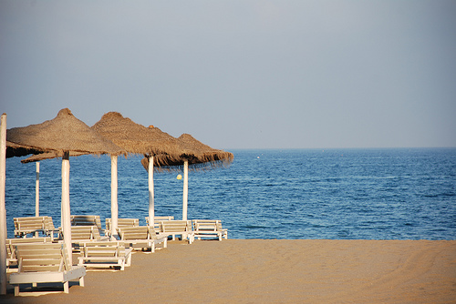
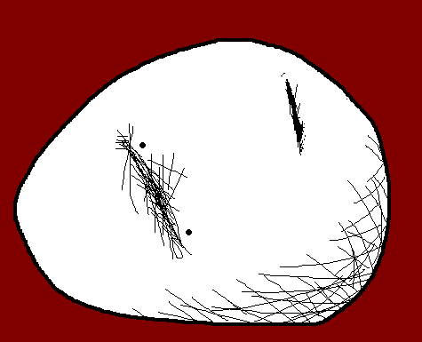

And the answer is very, very simple

Slide 5

The Subject Pronoun in a sentence is the person who is doing something!

Slide 6
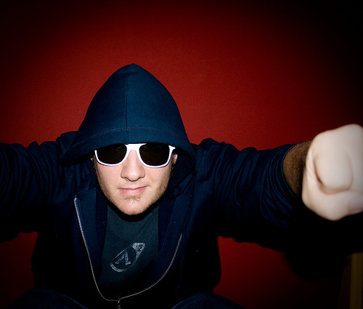
Let’s see some examples

Slide 7
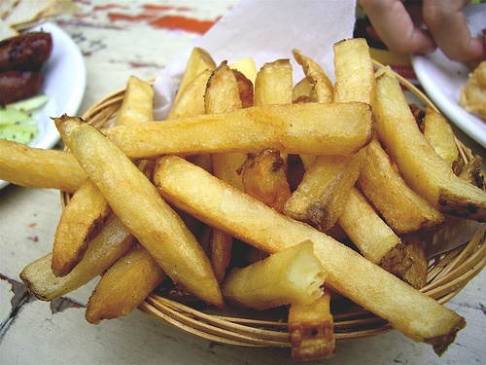
There we have some chips... uhm, yummy!

Slide 8
If it’s me who eats the chips, in English we would say:

Slide 9
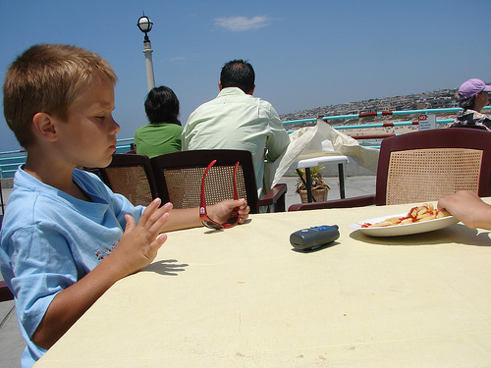
“I eat chips!”

Slide 10
In the sentence “I eat chips”, “I” is the Subject Pronoun

Slide 11
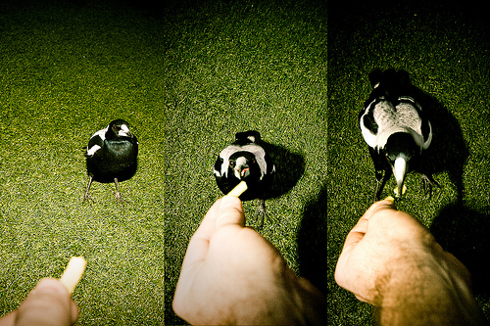
Well, despite what you might think, Spanish is not so different to English

Slide 12
If we wanted to say “I eat chips” we would say:

Slide 13
“¡Yo como patatas fritas!”

Slide 14
So “YO” is “I”

Slide 15

So, if we want to say “I” in Spanish, we need to say “YO”

Slide 16
I (in English)

YO (in Spanish)

Slide 17
“I eat chips!”

Slide 18
“¡Yo como patatas fritas!”

Slide 19
Now you are the one eating chips!

Slide 20
You eat chips!

Slide 21
¡Tú comes patatas fritas!

Slide 22
I know how clever you are, so, I am going to say it again, and you will tell me how we say “you” in Spanish

Slide 23
You eat chips!

Slide 24
¡Tú comes patatas fritas!

Slide 25
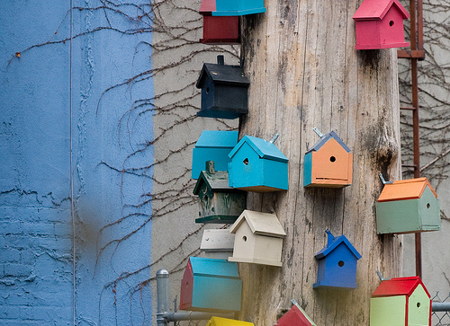
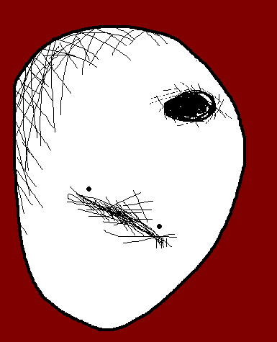
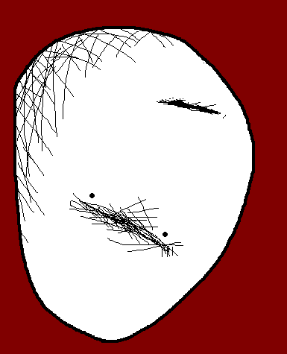
Any idea?... Come on... Have a go!

Slide 26
I am still waiting...

Slide 27
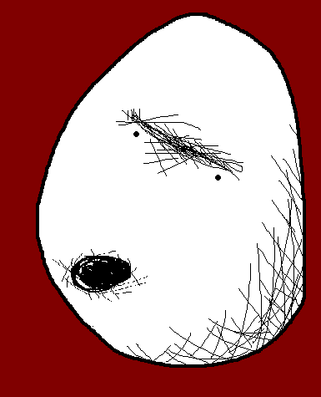
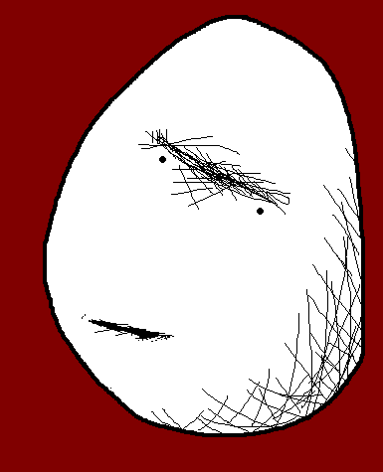
If we want to say “YOU” in Spanish,
we say “TÚ”

Slide 28
I (in English) | YOU (in English)
 | 
YO(in Spanish) | TÚ(in Spanish)

Slide 29
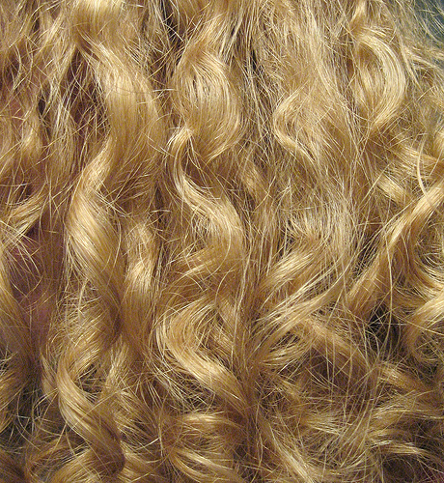
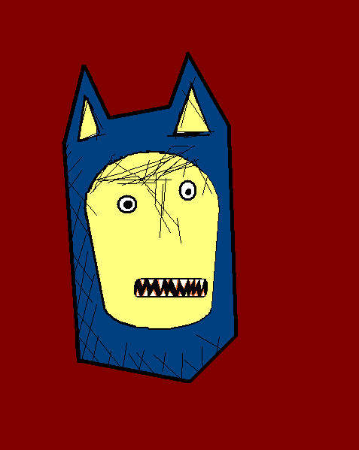
There is Mr. Confused and Angry Wolfman!

Slide 30
I wonder what he is doing...

Slide 31
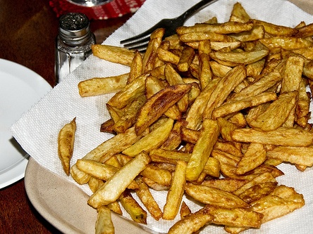


He eats chips!

Slide 32
Or in Spanish...

Slide 33
¡Él come patatas fritas!

Slide 34
HE eats chips!

Slide 35
¡ÉL come patatas fritas!

Slide 36
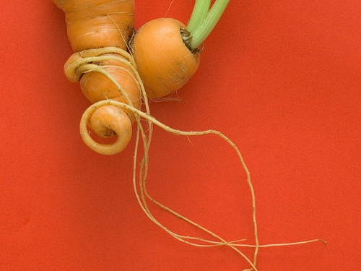

Who is that now?

Slide 37
It is Mrs Mildly-Angry Carrot-Face!

Slide 38
Guess what she is doing!

Slide 39
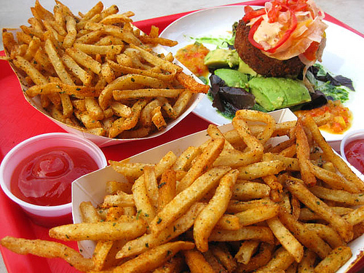


She eats chips!

Slide 40
¡Ella come patatas fritas!

Slide 41
SHE eats chips!

Slide 42
¡ELLA come patatas fritas!

Slide 43
I am sure you can fill the chart now with more information...

Slide 44
I (in English) | you (in English)
 | 
yo (in Spanish) | tú (in Spanish)

Slide 45
I (in English) | you (in English) | he (in English)
 |  | 
yo (in Spanish) | tú (in Spanish) | él (in Spanish)
I (in English) | you (in English) | he (in English)
 | 
yo (in Spanish) | tú (in Spanish)

Slide 46
I (in English) | you (in English) | he (in English) | she (in English)
 |  | 
yo (in Spanish) | tú (in Spanish) | él (in Spanish)

ella (in Spanish)

Slide 47
Say after me!

Slide 48
I (in English) | you (in English) | he (in English) | she (in English)
 |  |  | 
yo (in Spanish) | tú (in Spanish) | él (in Spanish) | ella (in Spanish)

Slide 49
I (in English) | you (in English) | he (in English) | she (in English)
 |  |  | 
yo (in Spanish) | tú (in Spanish) | él (in Spanish) | ella (in Spanish)

Slide 50
I (in English) | you (in English) | he (in English) | she (in English)
 |  |  | 
yo (in Spanish) | tú (in Spanish) | él (in Spanish) | ella (in Spanish)

Slide 51
I (in English) | you (in English) | he (in English) | she (in English)
 |  |  | 
yo (in Spanish) | tú (in Spanish) | él (in Spanish) | ella (in Spanish)

Slide 52
And if you are wondering now how to say “it” in Spanish... The answer is...

Slide 53
In Spanish there is no such word!! Ha, ha, ha!!

Slide 54
















Join us again!

