Slide 1



10 Survival Phrases
Survival Answers 6/6
With Mr Angry Potato Head and
Mrs. Mildly-Angry Carrot-Face

Slide 2


Hello I am the angry potato-head. I have already taught you ten survival phrases. Here are some answers.

Slide 3
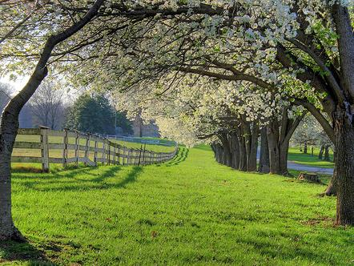

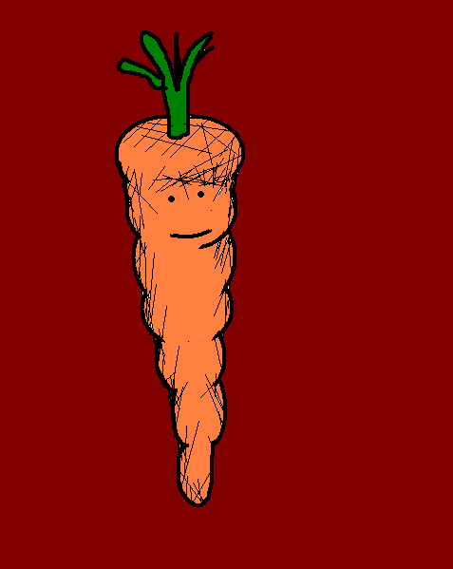
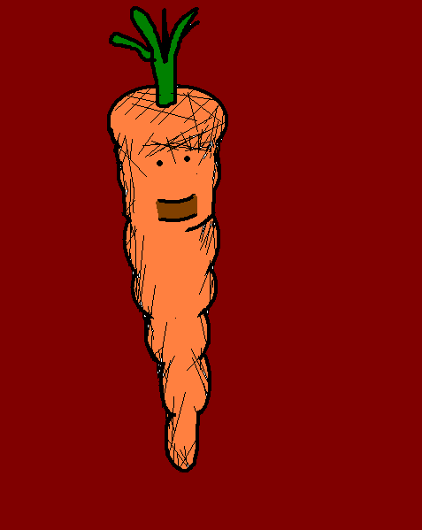
Hello. I am the mildly angry carrot-face. I am going to teach you answers to the survival phrases.
Hello. I am the mildly angry carrot-face. I am going to teach you answers to the survival phrases.

Slide 4
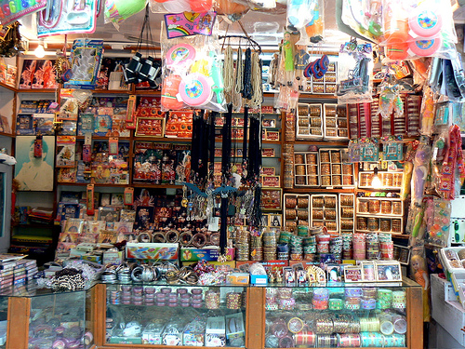

¿Cuánto cuesta esto?
How much does that cost?

Slide 5

Quince euros con noventa y nueve.
€15.99

Slide 6
¿Cuánto cuesta esto?
How much does that cost?

Slide 7
Hoy tenemos una oferta especial. Está a mitad de precio.
We have a special offer on today.
It’s half price.

Slide 8
¿Cuánto cuesta esto?
How much does that cost?

Slide 9
¿Cuánto me da por esto?
How much are you offering?

Slide 10
¿Cuánto cuesta esto?
How much does that cost?

Slide 11
Más de lo que puede pagar.
More than you can afford.

Slide 12
¿Tiene algo más barato?
Do you have anything cheaper?

Slide 13
¿Qué tal éste?
You could try this one instead.

Slide 14
¿Tiene algo más barato?
Do you have anything cheaper?

Slide 15
Éste es el más barato.
This is the cheapest one.

Slide 16
¿Lo tiene en rosa?
Do you have a pink one?

Slide 17
Lo siento, sólo lo tenemos en morado.
I’m sorry, we only have purple ones.

Slide 18
















Join us again!

