Slide 1

Handy Questions 1
-
What Is Your Name?
With the Unusual Mike Rophone

Slide 2
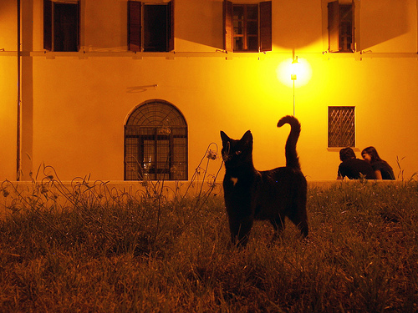


Hello. My name is the Unusual Mike Rophone. I like to ask questions, and so do you. Hahahahahaha.

Slide 3
Perdona. ¿Cómo te llamas?
Excuse me. What is your name?

Slide 4



Hola, me llamo Angry Potato-Head.
Hello, my name is Angry Potato-Head.

Slide 5
Perdona. ¿Cómo te llamas?
Excuse me. What is your name?

Slide 6



Hola. Me llamo Mildly-Angry Carrot-Face.
Hello. My name is Mrs Mildly-Angry Carrot-Face.

Slide 7
Perdona. ¿Cómo te llamas?
Excuse me. What is your name?

Slide 8
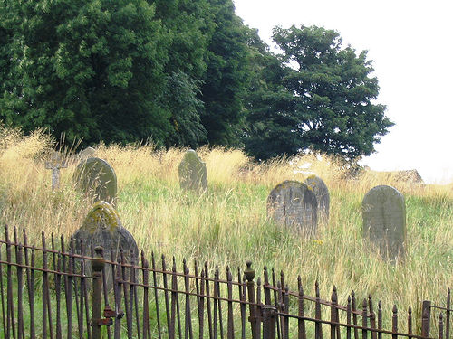


Hola. Me llamo Miss Remotely Angry Lightening Bulb.
Hello. My name is Miss Remotely Angry Lightening Bulb.

Slide 9
Perdona. ¿Cómo te llamas?
Excuse me. What is your name?

Slide 10
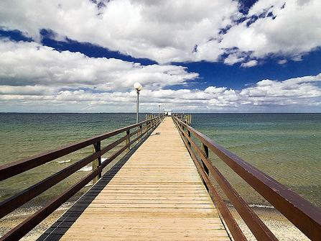


Hola, me llamo Mr. Angry Toaster-Brow.
Hello. My name is Mr Angry Toaster-Brow.

Slide 11
Perdona. ¿Cómo te llamas?
Excuse me. What is your name?

Slide 12
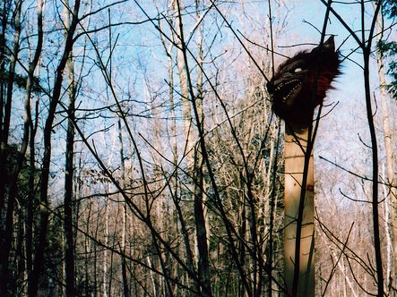


Hola, me llamo Confused and Angry Wolfman.
Hello, my name is Confused and Angry Wolfman.

Slide 13
Perdona. ¿Cómo te llamas?
Excuse me. What is your name?

Slide 14



Hola, me llamo Angry Cloud-Ghost.
Hello, my name is The Angry Cloud-Ghost.

Slide 15
Mmmm. I’m sure I had another question. But, I’ve forgotten it. Well it was nice speaking to you. Goodbye.

Slide 16














Join us again!

