Slide 1

Handy Questions 4
-
Brothers and Sisters
With the Unusual Mike Rophone

Slide 2
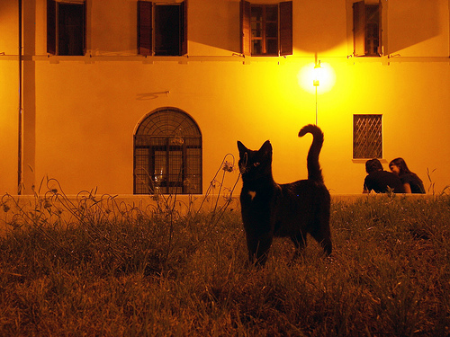


Hello. I was just talking with my brother and sister, and I thought of a question.

Slide 3
¿Cuántos hermanos tienes?
How many brothers and sisters do you have?

Slide 4


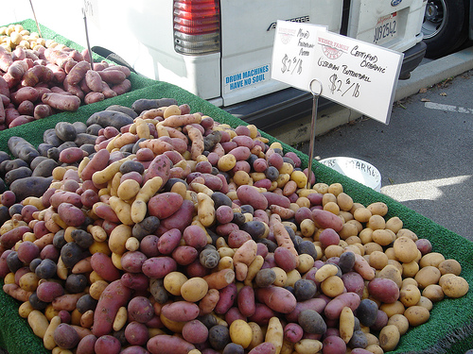
Tengo muchos hermanos y hermanas.
I have lots of brothers and sisters.

Slide 5
¿Cuántos hermanos tienes?
How many brothers and sisters do you have?

Slide 6
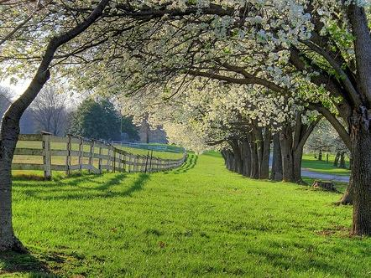


Tengo ocho hermanos y dos hermanas.
I have eight brothers and two sisters.

Slide 7
¿Cuántos hermanos tienes?
How many brothers and sisters do you have?

Slide 8



I have no brothers or sisters.
No tengo hermanos ni hermanas.

Slide 9
¿Cuántos hermanos tienes?
How many brothers and sisters do you have?

Slide 10
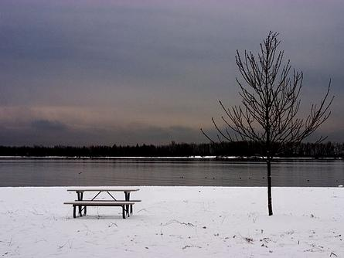


Yo tengo un hermano y dos hermanas.
I have one brother and two sisters.

Slide 11
¿Cuántos hermanos tienes?
How many brothers and sisters do you have?

Slide 12


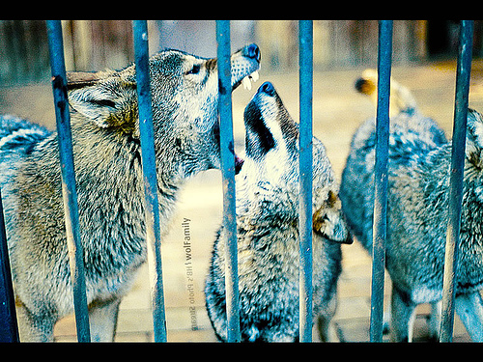
Tengo tres hermanos y dos hermanas.
I have three brothers and two sisters.

Slide 13
¿Cuántos hermanos tienes?
How many brothers and sisters do you have?

Slide 14


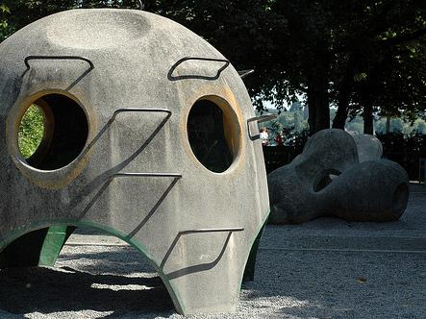
Tengo una hermana pero no tengo hermanos.
I have no brothers and one sister.

Slide 15
Lovely. I like questions but I’ve got to go.
My tea is ready.

Slide 16














Join us again!

