Slide 1
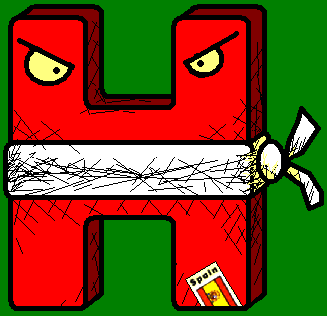

SH
HH!
The Silent H
With the Angry Spanish Ninja H

Slide 2
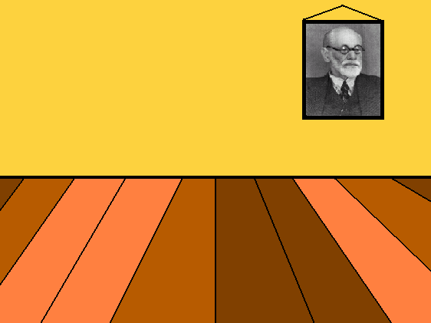
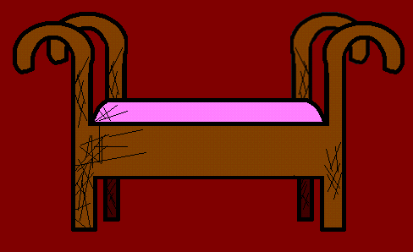
Come in, please.

Slide 3
So, Spanish H, what is the matter?

Slide 4
The matter is I feel useless.

Slide 5
Oh, do tell me about it.

Slide 6
The thing is, nobody pays any attention to me; it’s as if I didn’t exist...
(The H has a seat)

Slide 7
If I only was like my English cousin...
(The H has a seat)

Slide 8
Why do you say that?
(The H has a seat)

Slide 9
Look, I am a Spanish Ninja H, and we are all SILENT, but the English H’s make a sound, let me show you...
(The H has a seat)

Slide 10

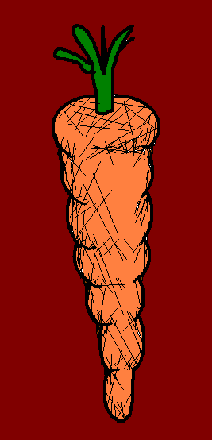
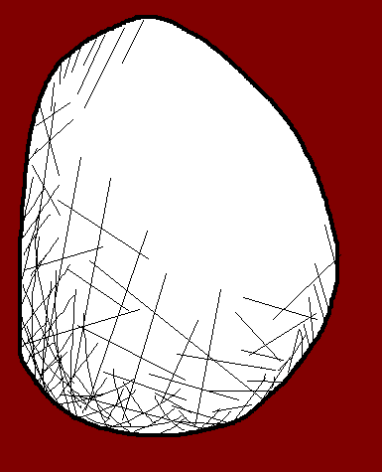
ello
Hello

Slide 11
un ealthy
unhealthy
Ah, the wonderful sound of the English H!!

Slide 12
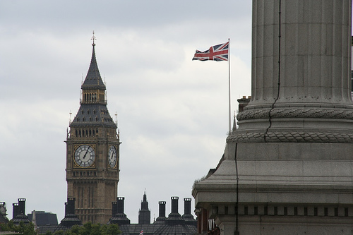

Slide 13
ermanos
hermanos
That is “brothers and sisters” in Spanish, isn’t it?

Slide 14
ora
hora
“¿Qué hora es?” means “what time is it?”

Slide 15
elado
That’s “ice cream”! I love ice cream, but only if it is pink!
helado
Me too! But it has to be orange!

Slide 16




Honestly, I can’t see the point in the Spanish Ninja H.
It never makes any sound at all!
Yeah, you are right; it should look for another job

Slide 17
Can you see, Doctor?

Slide 18
Doctor?...

Slide 19
DOCTORRR?!...

Slide 20
Oh, sorry, Spanish H, I fell asleep.
You’re just so quiet...

Slide 22

But... Spanish Ninja H, what are you doing!?

Slide 23
NOOOO!!

Slide 24
I don’t make a sound...
... But I do make pain...

Slide 25















Join us again!

