Slide 1



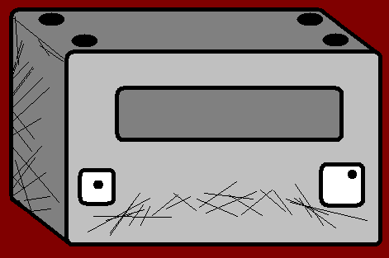



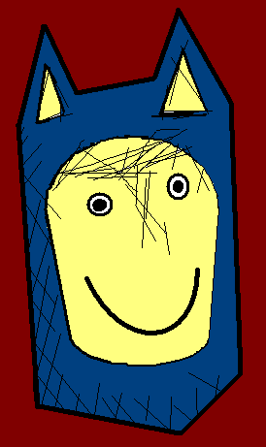





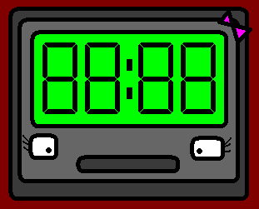

The Angry Family
The Beginning…

Slide 2
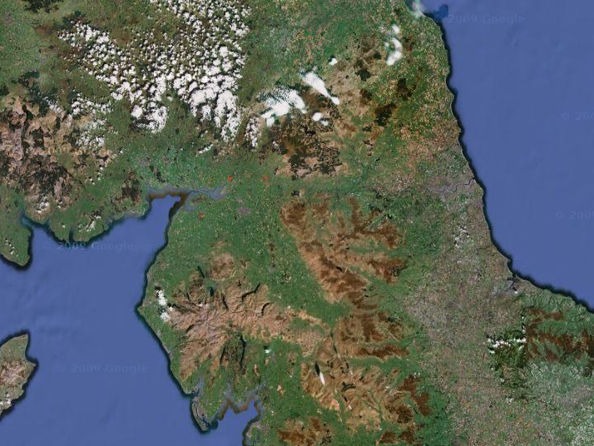
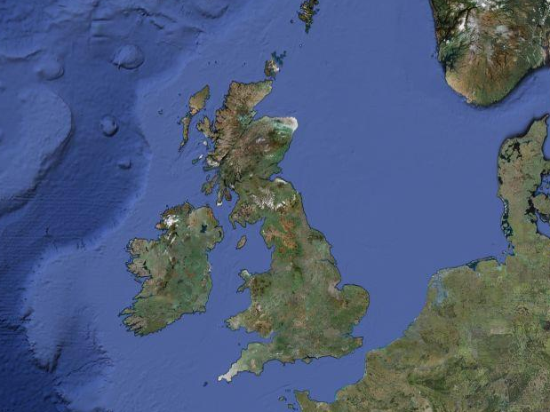
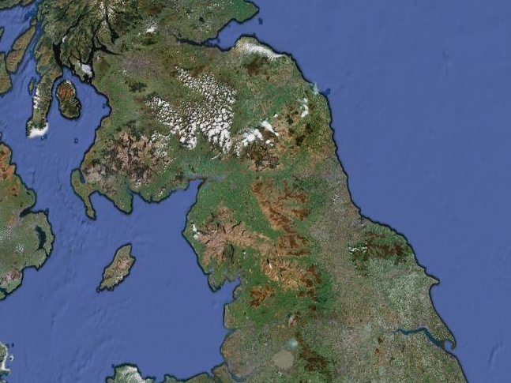
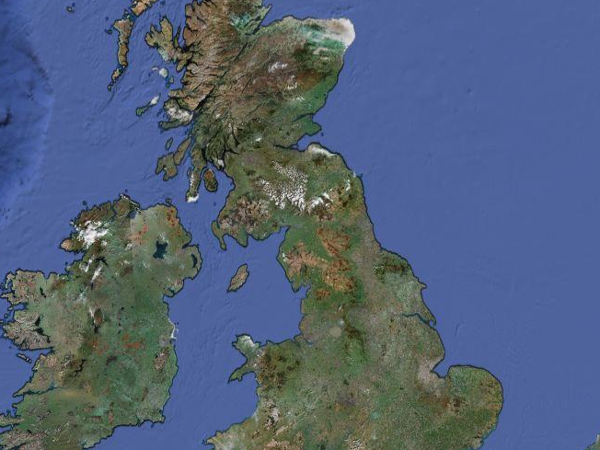
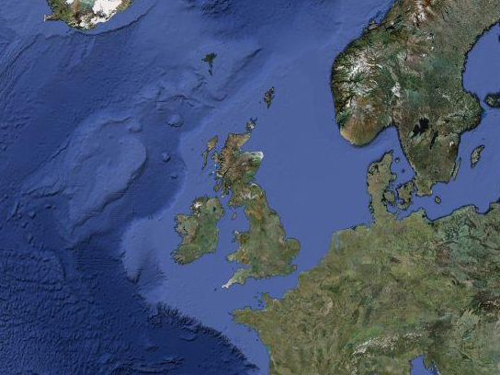
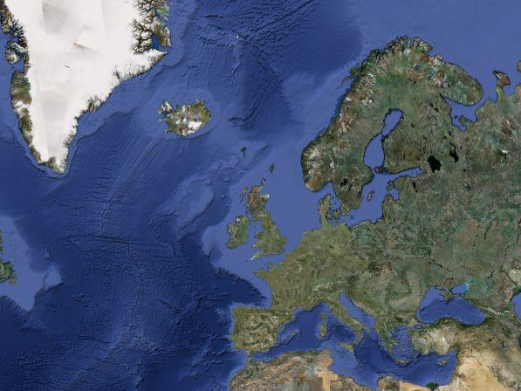

Somewhere in the North East of England…

Slide 3
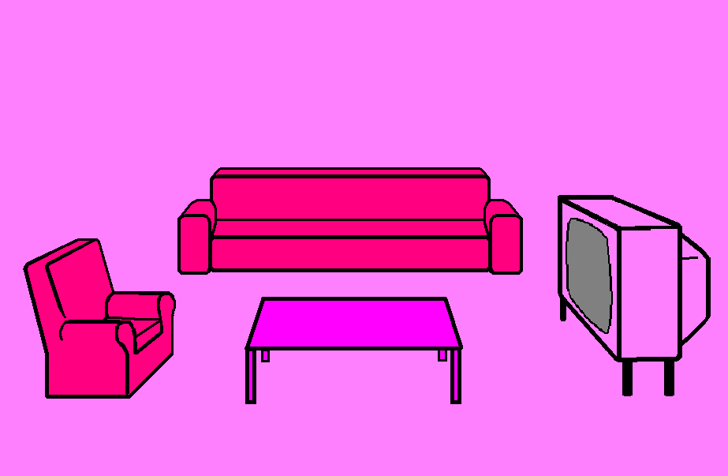



I need to do two things, study French, and adopt a family of like minded people to help me.

Slide 4
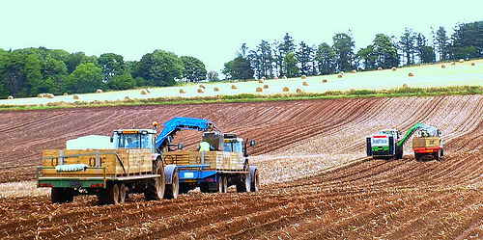


Bonjour !

Slide 5














Au revoir !

Slide 6
I’ll go and put an advert out, and find my lovely pineapple.

Slide 7
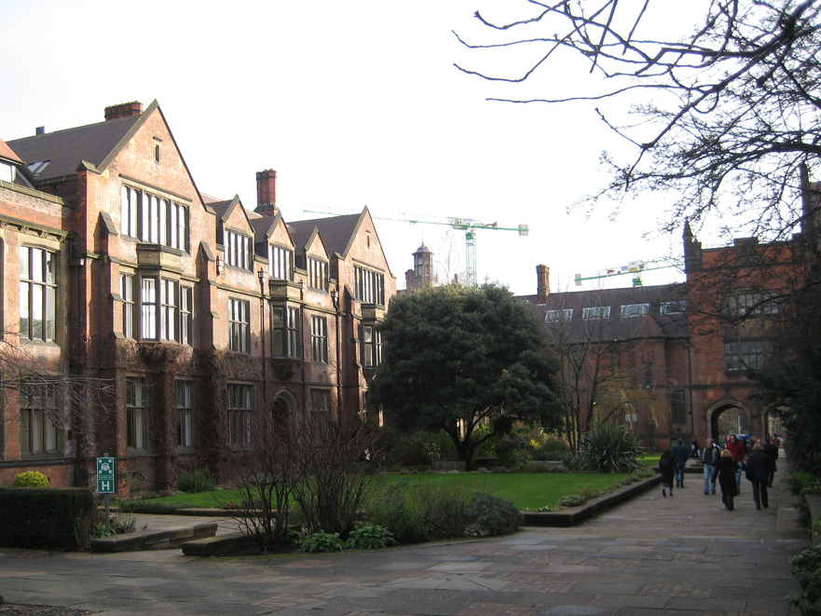

Wanted:
family for learning languages

Slide 8
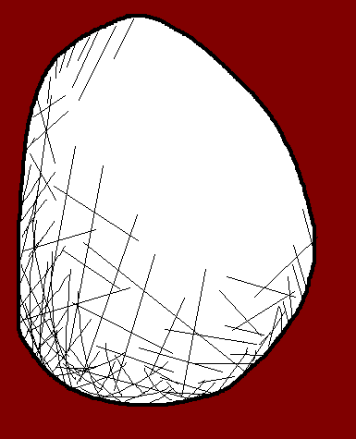

Hmmmmm
Wanted:
family for learning languages

Slide 9
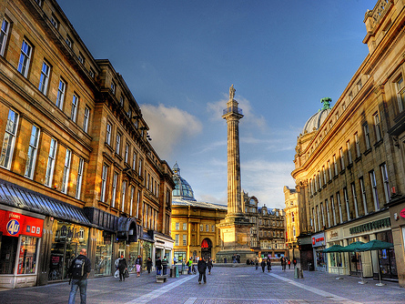

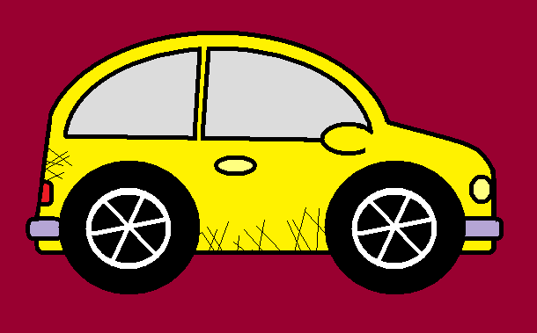
Wanted:
family for learning languages

Slide 10
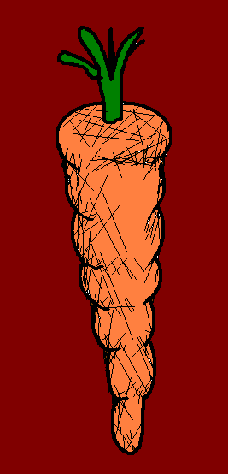
Wow !
Wanted:
family for learning languages

Slide 11
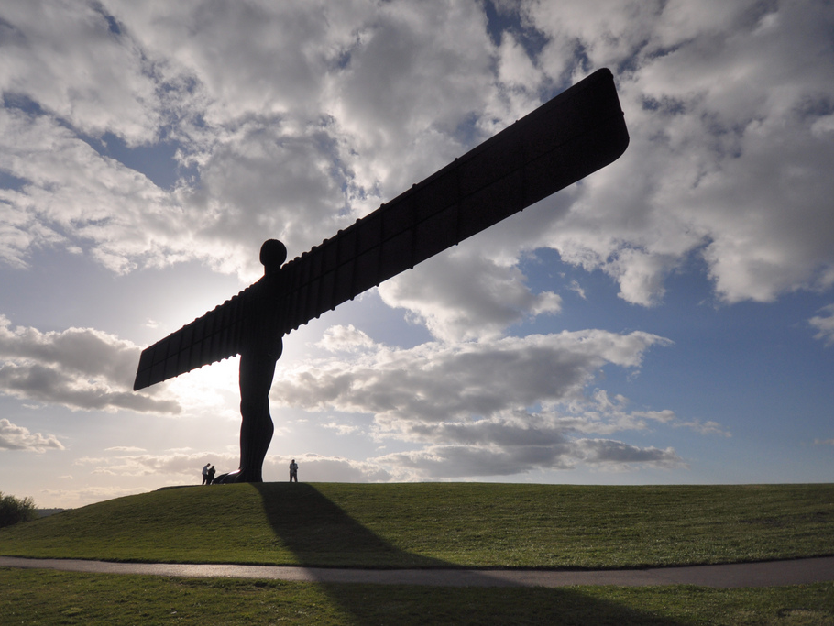



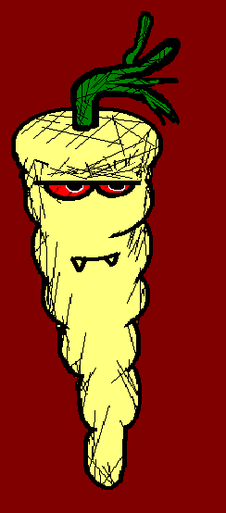

Slide 12
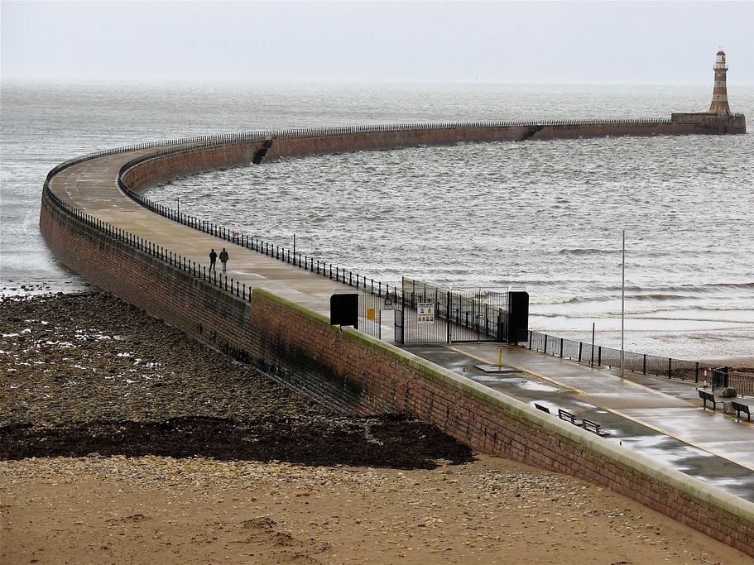
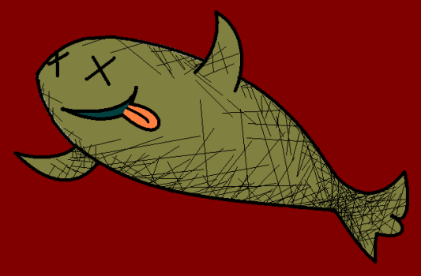



Wanted:
family for learning languages

Slide 13
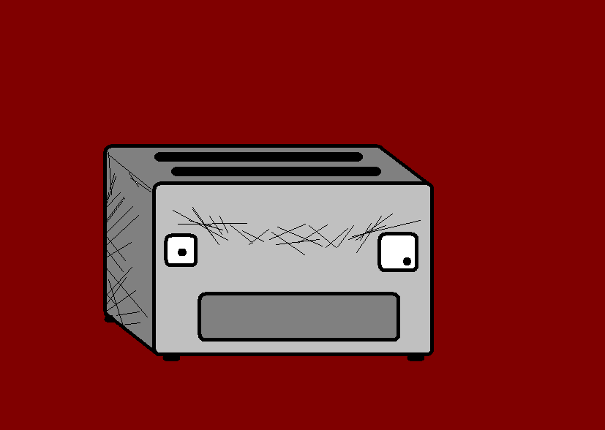



Génial !
Wanted:
family for learning languages

Slide 14



Délicieux !
Wanted:
family for learning languages

Slide 15
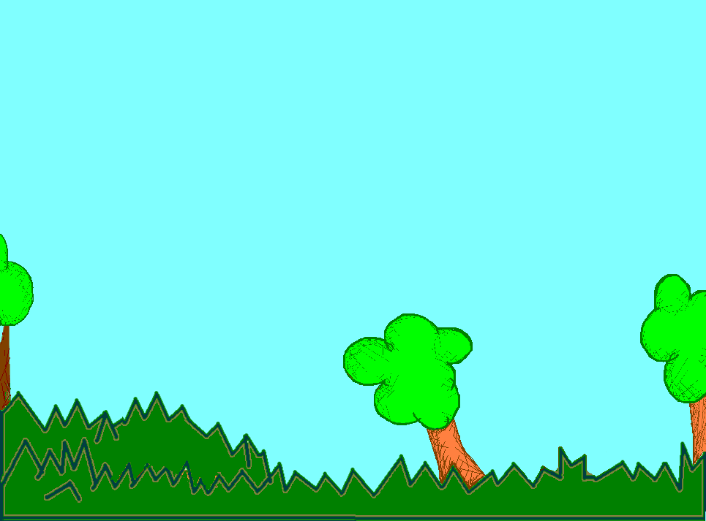

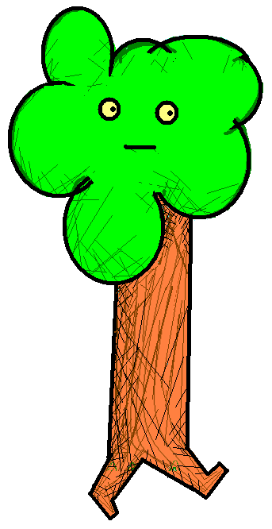
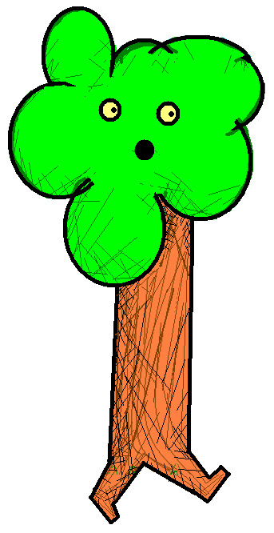
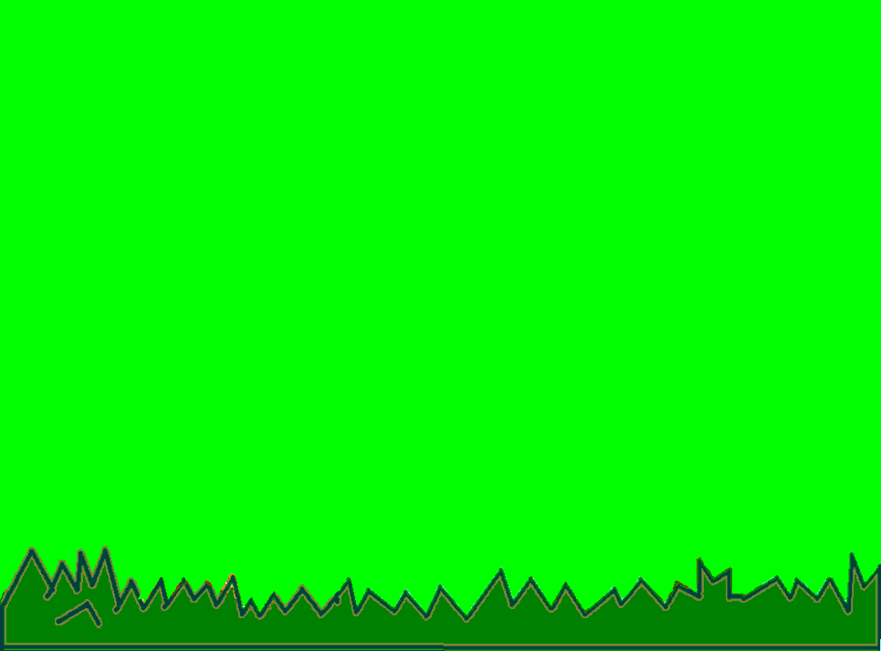

Slide 16
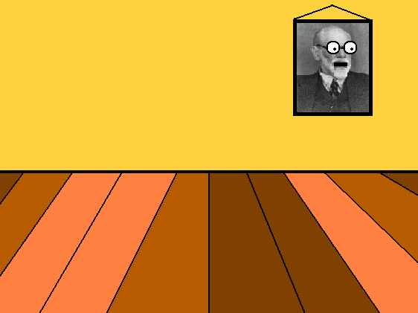


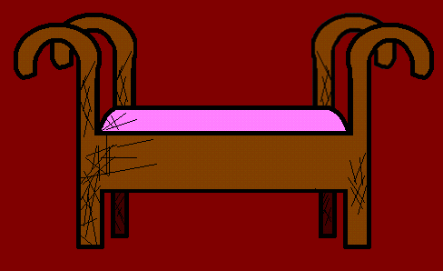

Slide 17
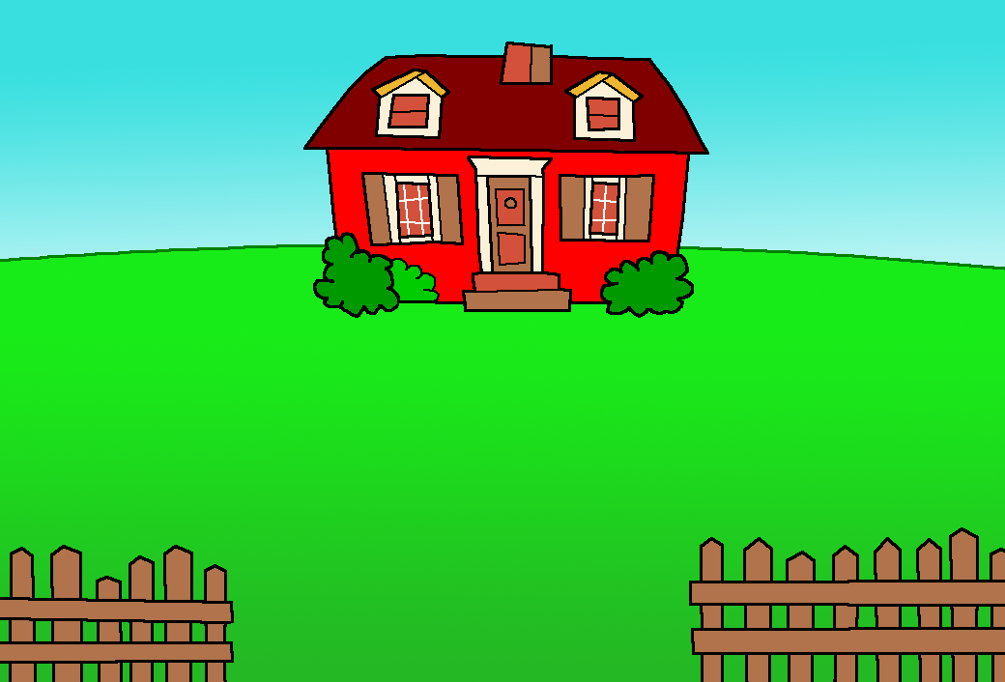
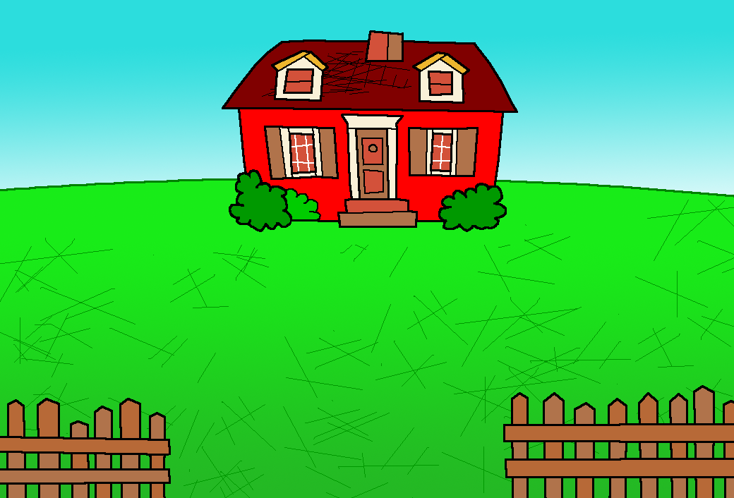



Slide 19




We’re here to learn languages, but we’re all hungry.

Slide 20
Angry? You don’t look angry! Apart from you Mr. Angry Potato Head. What are you angry about?

Slide 21

I’m not, I’m just hungry. We’re all hungry.

Slide 22
Angry?!?

Slide 23
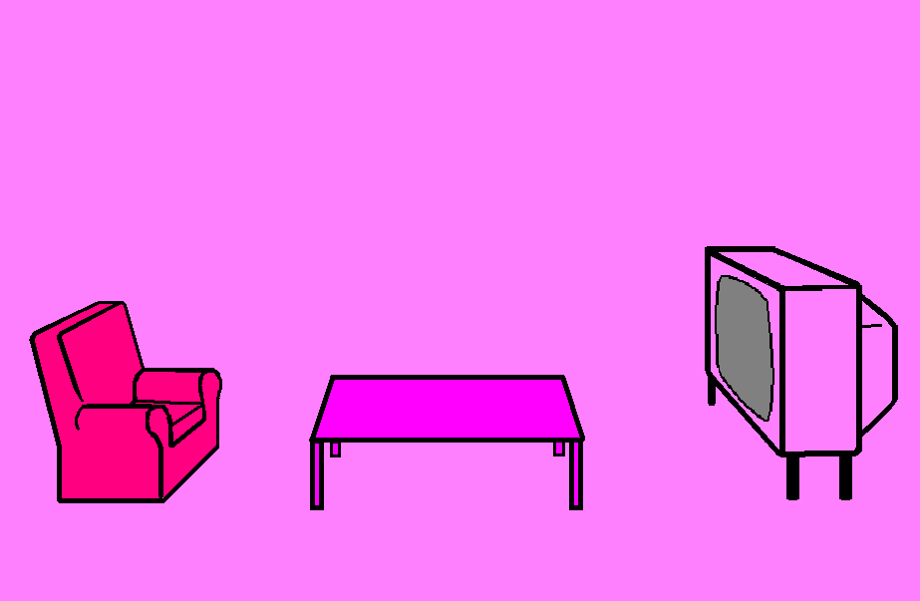

HUNGRY!!!!

Slide 24

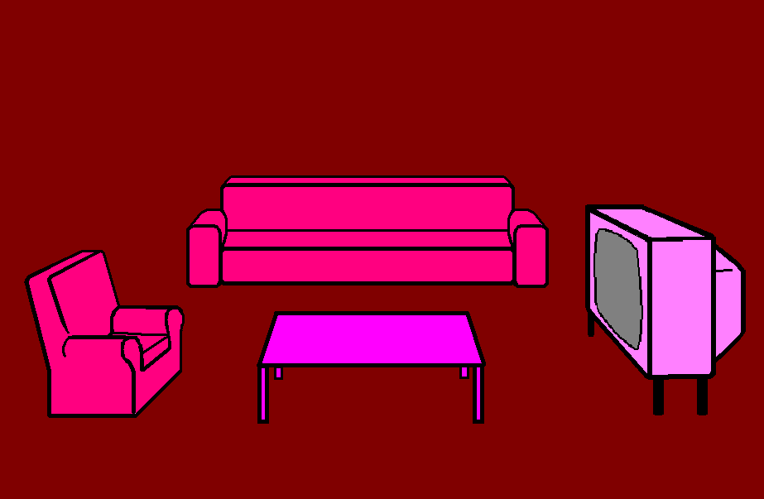


Angry?!?

Slide 25



I guess we’ll call ourselves the Angry Family then.
Sigh. OK.
Sigh. OK.
Sigh. OK.
Sigh. OK.
Sigh. OK.

Slide 26
What a lovely pink room.

Slide 27

…and so it begins…

Slide 28











Join us again!

